Slide 1
What is the status of my invoice?
The Accounts Payable (Invoice)-On Line Web Center, located on the NJDOT Intranet will provide you with information on the status of your invoice.

Slide 2
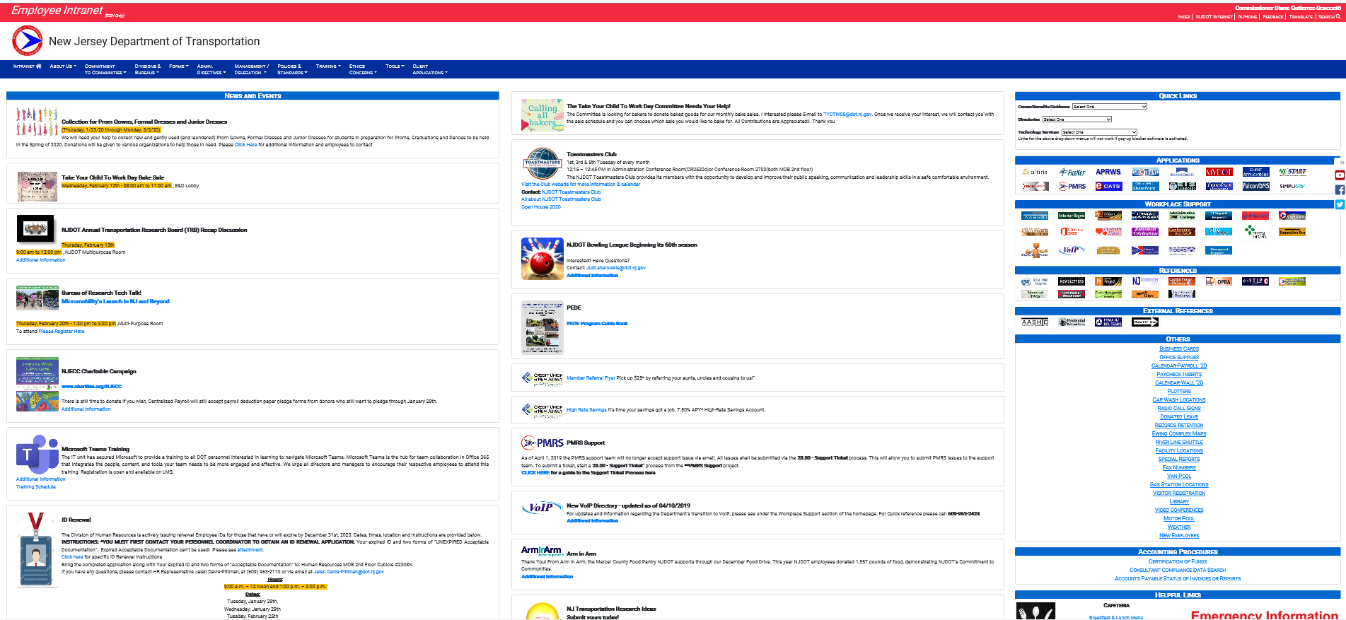
Access the NJDOT Intranet (http://njdotintranet.njdot.lan/) then navigate to “Others”

Slide 3
Click on Special Reports

Slide 4
Click on Accounting

Slide 5
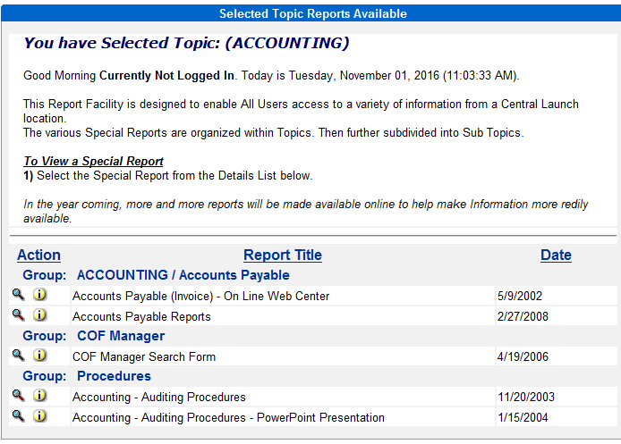
Click Once On Accounts Payable (Invoice) On Line Web Center

Slide 6
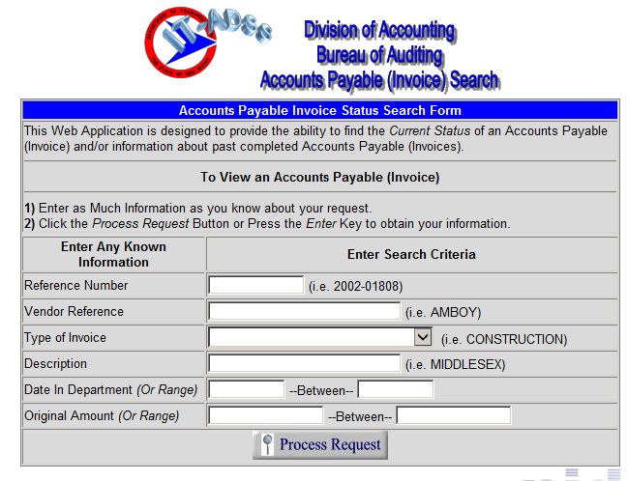
Enter Search Criteria And Click On Process Request
Vendor Reference is the Vendor Name. Note that it will bring you back every invoice that is related to that vendor.
Date In Department: Use the exact date or a range
NO COMMAS PLEASE when using the Original Amount.
Put in the exact amount or a range.

Slide 7
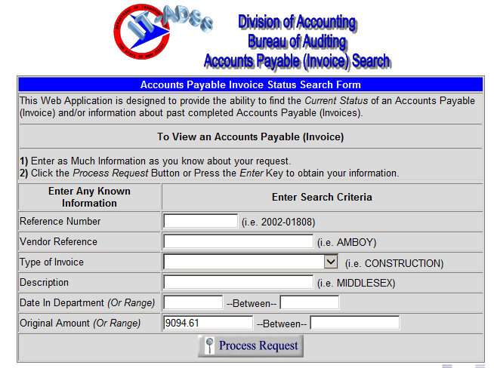
Example Of A Search Using An Exact Amount

Slide 8
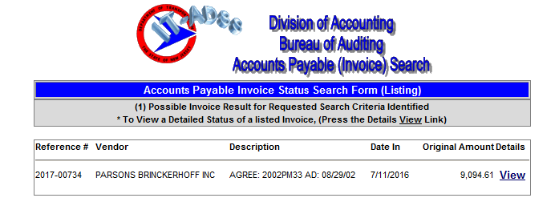
This Search Returned One Record – Click On View

Slide 9
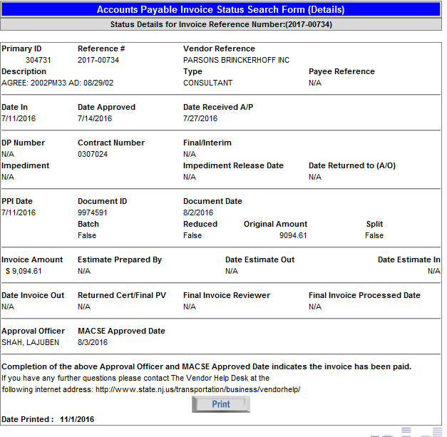
Status of Invoice
Date In = Date In Department (PPI)
Date Approved = Date Approved By Engineering Supervisor
Date Received A/P= Date Invoice Was Received in Accounting Operations.
Vendor Name
Document ID Indicates The Invoice Has Been Keyed Into MACSE
Invoice Amount Equals The Amount Entered Into The Search
Date Approved For Payment In MACSE

Slide 10
Click Once On Accounts Payable (Invoice) On Line Web Center –Viewing Reports

Slide 11
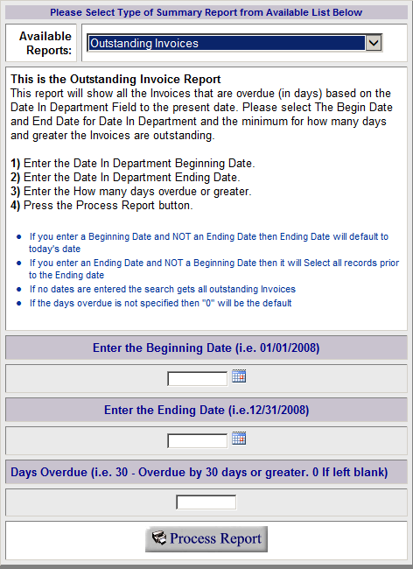
Click On Drop Down To View A List Of Available Reports
Note That Directions Are Provided. Please Read Prior to Processing A Report.

Slide 12
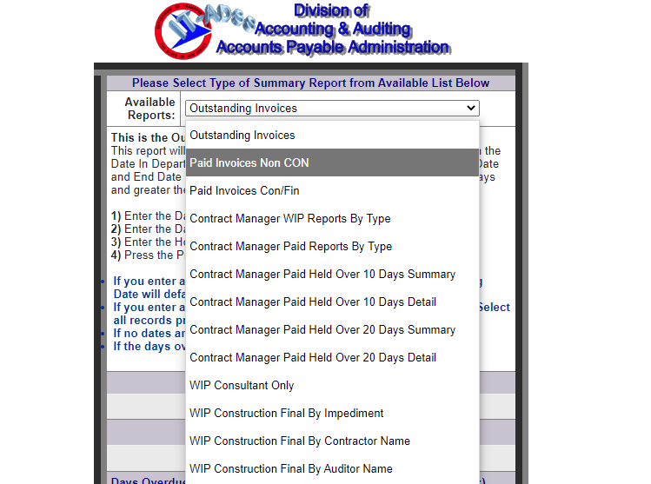
List Of Available Reports: Clicking on the down arrow next to Available Reports will give you a list of reports to choose from as shown to the left. Note: -Paid Invoices Non CON represents all paid invoices except for construction and construction final.
-Paid Invoices Con/Fin represent all paid construction and construction final estimates.

Slide 13
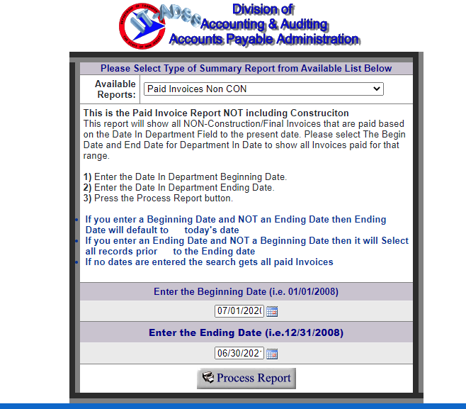
Example Report Representing Paid Invoices Non CON for FY 2021
Read instructions
Enter the appropriate fiscal year or period that you are interested in.
Click once of Process Report

Slide 14
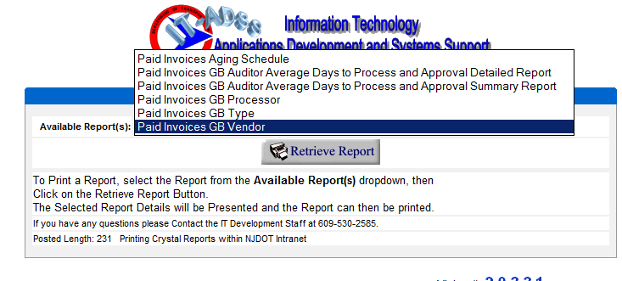
Select From The Available Reports – Paid Invoice GB Vendor is used in this example

Slide 15
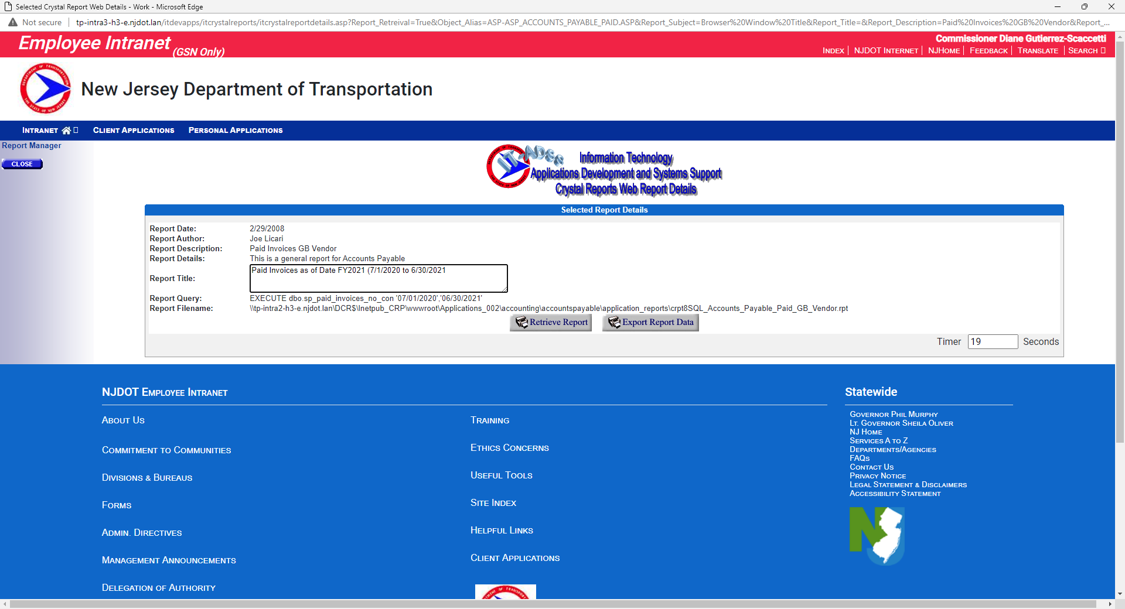
Enter Appropriate Information In Report Title
Click once on Retrieve Report

Slide 16
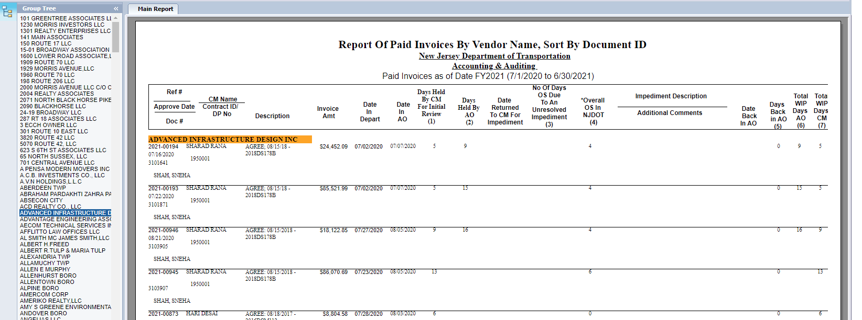
Resulting Report
Select Vendor By Scrolling Through The Vendor Names And Clicking Once On The Vendor Name To Select.

Slide 17
Questions

