Slide 1
Guide Rail Presentation
Presented by:
Hung Tang
Roadway Standards Unit
NJDOT
March 2019

Slide 2
NJDOT Roadway Standards Unit
Our responsibility is to ensure that the standards in our design documents are complete and updated as needed.
We don’t usually provide guide rail presentation or training.
We have experienced many times where guide rail related inquires on projects are first directed to our office for resolution when they really belong with project designers.
It is important not to bypassing the designer, in order to ensure they are included in decisions, as they are the one who is ultimately responsible for the project design.

Slide 3
Safety Audit of Fatalities and Injuries Involving Guide Rail Report # FHWA-NJ-2007-001
Each year in NJ, approx. 10,000 vehicles occupants (27 per day) are exposed to crashes involving a GR impact. In crashes in which the GR was the most harmful object struck, approximately 10-12 persons were fatally injured and 100 persons received incapacitating injuries. Approx. 40 fatal crashes involved a GR impact of some nature
In general, GR in NJ perform well in crashes. GR crashes fortunately result in only a small fraction (1.5%) of NJ highway deaths. 3/4ths of all occupants exposed to GR crashes suffer no injuries.
State highways are overrepresented in serious GR collisions. State highways account for 23% of all GR crashes, but 30% of all fatal and incapacitating GR crashes.
The State of NJ does not have an unusually high percentage of GR fatalities. NJ ranks only 20th among the states in terms of GR fatalities as a percentage of all traffic fatalities.

Slide 4
Some Reasons Why Guide Rail Impacts Sometimes Lead to Fatality or Injury
Improper installation
Impacts with end treatments
Unfavorable roadside conditions, (ie: excessive side slope)
Side impact
Improper redirection after a crash
Wheel snagging
Secondary impacts with fixed objects

Slide 5
Guide Rail Performance Can Also Be Affected By Vehicle Design
Light trucks overturning on impact with guide rail
Cars “submarining” under guide rail
Airbag induced injuries
Incompatibility with heavy trucks

Slide 6
Guide Rail Does Not Always Work As Expected - Rollover Is A Possibility

Slide 7
End Treatments Entering Passenger Compartment

Slide 8
The driver was a 22 year old Washington student heading to College in Idaho. He fell asleep at the wheel and drifted off the shoulder hitting the end of the guide rail in Montana. The guide rail came through the right headlight, engine compartment, passenger seat, rear seat and exited out the driver’s side rear window (120 LF of guard rail threaded through the Suburban). No passengers and the driver was not injured.

Slide 9
Curb, Berm or Even Snow Can Affect Guide Rail Performance

Slide 10
High Angle Hits Can Cause Failure

Slide 11
High Angle Hits Can Cause Failure

Slide 12
Historical Review
Document Source | Year Issued | Number of Pages | Test Vehicle & Weight
HRB #482 | 1962 | 1 | 4400 lb. car
NCHRP #115 | 1971 | 70 | 4000 to 5000 lb. cars.
NCHRP #118 | 1972 | 96 | 2000 & 4500 lb. cars
NCHRP #153 | 1974 | 19 | 2250 & 4500 lb. cars
TRC #191 | 1978 | 27 | 2250 & 4500 lb. cars
NCHRP #230 | 1981 | 42 | 1800 & 4500 lb. cars
NCHRP #350 | 1993 | 132 | 1800 lb. car & 4400 lb. Pickup
MASH | 2009 | 259 | 2420 lb. Car & 5000 lb. Pickup
MASH | 2016 | 279 | 2420 lb. Car & 5000 lb. Pickup

Slide 13
History of Guide Rail Testing
Rewrite of NCHRP 350
The rewrite of NCHRP 350 is completed. It was reviewed by the AASHTO Technical Committee on Roadside Safety (TCRS) and is an AASHTO document.
It's called The AASHTO Manual for Assessing Safety Hardware (2009), “MASH” for short.
This rewrite updated the test vehicles, the impact condition criteria, and the evaluation criteria.
A 2nd edition of MASH with minor changes was published in 2016.

Slide 14
MASH
As part of the rewrite of NCHRP 350, there were three main focus areas:
Test Vehicles were updated to what's being produced and sold today.
Impact Condition Criteria were modified to correct inconsistencies and identify needed conditions.
Evaluation Criteria were modified to correct subjective criteria and better define other criteria.
Some of the more significant changes from the NCHRP 350 conditions to the AASHTO MASH conditions:
Pickup truck increases from 4,400 lbs. to 5,000 lbs.
Small car increases from 1,800 lbs. to 2,420 lbs.
Small car impact angle changed from 20 to 25 degrees.
Terminal & Crash Cushion impact angle changed from 20 to 25 degrees.
TL-4 truck increases from 17,600 lbs. to 22,000 lbs.
TL-4 truck speed changed from 50 MPH to 56 MPH
More of the major differences between MASH and NCHRP 350 can be seen at the following link: https://bookstore.transportation.org/imageview.aspx?id=708&DB=3

Slide 15
MASH 2016 IMPLEMENTATION AGREEMENT
When MASH 2009 was published, AASHTO anticipated manufacturers would take the initiative to develop MASH compliant devices, but this did not happen
Joint FHWA/AASHTO agreement issued 1/7/2016
Additional safety benefits of MASH could only be realized if new hardware was developed
Incentive: sunset NCHRP 350 criteria for new devices
Staggered implementation approach

Slide 16
IMPLEMENTATION DATES
As of May 26, 2017, all devices in the FHWA queue that have not received an eligibility letter, and those requests received after January 1, 2016 must be tested as described in MASH 2016.
Only safety hardware evaluated using the MASH 2016 criteria will be allowed for new permanent installations and full replacements on contracts with a letting date after the following dates:
December 31,2017: w-beam guiderail and cast-in-place concrete barriers
June 30, 2018: w-beam guiderail terminals
December 31, 2018: cable barriers, cable barrier terminals, and crash cushions
December 31, 2019: bridge rails, transitions, all other longitudinal barriers (including portable barriers installed permanently), other terminals, sign supports, and all other breakaway hardware
The AASHTO/FHWA joint implementation agreement can be seen at the following link:
https://safety.fhwa.dot.gov/.../memo_joint_implementation_agmt.pdf

Slide 17
IMPLEMENTATION DATES
FHWA Memorandum (6/28/18)
The sunset date June 30, 2018 for w-beam terminals now only cover tangent terminals. Other applications such as double-sided or median terminals, flared terminals, and terminals installed on a flare, are included in the December 31, 2019, sunset date for “all other terminals.”
FHWA Memorandum (8/6/18)
Cable barriers and cable barrier terminals are now included in the December 31, 2019, sunset date for “all other longitudinal barriers” and “all other terminals.”
FHWA Memorandum (12/20/18)
If a State DOT requests federal-aid reimbursement for a NCHRP 350 crash cushion (that has not been evaluated with the MASH 2016 crash test criteria) on the NHS, then the State should provide an explanation to FHWA. FHWA will determine if the installation of the NCHRP 350 crash cushion is acceptable.

Slide 18
1930/40’s Longitudinal Barrier RESETTING “WIRE ROPE FENCE” 8/30/1945 to 7/1976

Slide 19
Brief History on Guide Rail (1956 to 1973) 5’-9” Posts at 12.5’ Post Spacing, No Washers, No Blockouts, No Back Up Plates, No End Treatments
1970 to 1973 added rectangular washers and 13” high blockouts. 4/22/68 started attaching guide rail to parapets

Slide 20
Brief History on Guide Rail in NJDOT (9/26/73 - 7/29/88) 5’-9” Posts at 6’-3” Post Spacing, Rectangular Washers, 13” High Steel Blockouts, No back Up Plates (Pre-NCHRP 230)
3/13/84 Federal Technical Advisory said stop using rectangular washers and start using backup plates
Approach End Terminals:
Beam GR Anchorage: 1973 to July 1976
BCT: January 1976 to March 1996

Slide 21
Brief History on Guide Rail in NJDOT (7/29/88 - 2/11/99) 6’ Posts at 6’-3” Post Spacing, 14” High Steel Blockouts, Back Up Plates, No Washers (NCHRP 230)
Approach End Terminals:
BCT: January 1976 to March 1996
NCHRP 350 Terminals: March 1996 to projects awarded before 12/31/2017

Slide 22
Brief History on Guide Rail in NJDOT (2/11/99 - Present) 6’ Posts at 6’-3” Post Spacing, Wooden (Up to 12/20/2007) or Synthetic Blockouts, No Washers, No Back Up Plates (NCHRP 350)

Slide 23
Actual Hit on Guide Rail 6’-3” Post Spacing, Wooden Blockouts, No Washers, No Back Up Plates

Slide 24
Synthetic Block Outs – 2-11-99

Slide 25
Midwest Roadside Safety Facility
University of Nebraska – Lincoln
Research began in 2000 to modify W-beam
to accommodate higher center of gravity
vehicles and address rail ruptures

Slide 26
31” High Midwest Guide Rail System
Reduced high center of gravity vehicle rollover
Improved re-direction capacity
Adopted by NJDOT in 2017
For Projects Awarded after 12/31/2017

Slide 27
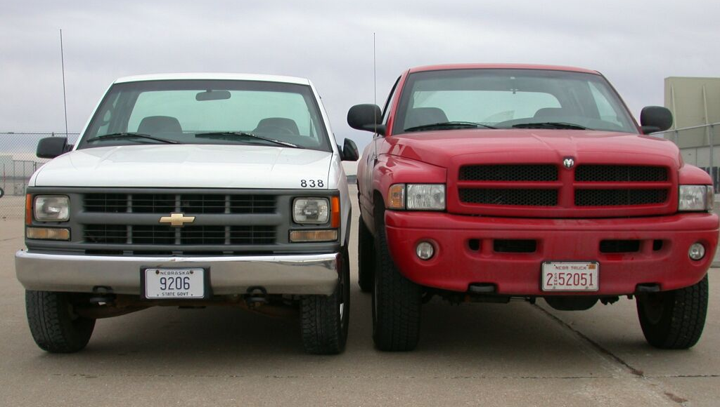
Pre-MGS W-beam Guide Rail Issues
Increase in size of vehicle fleet
High center of gravity vehicle rollover rates
Rail ruptures at post splices

Slide 28
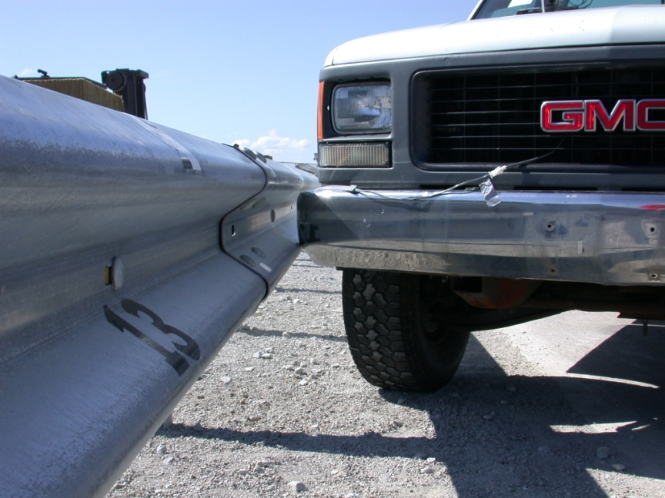
MGS Increased Rail Height
Improved capture & reduced rollover potential
Pre-MGS – 4,400 lbs.
MGS – 4,400 lbs.
27 ¾” rail height
31” rail height

Slide 29
Pre-MGS W-beam Rail Rupture

Slide 30
Pre-MGS W-beam High Center of Gravity Rollover

Slide 31
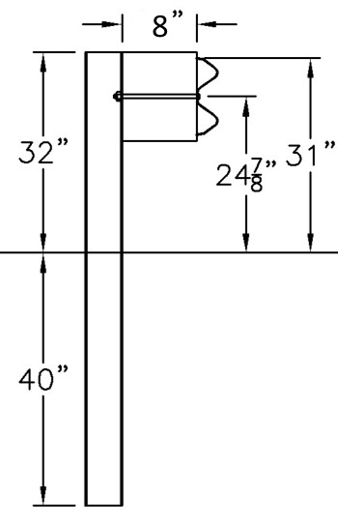
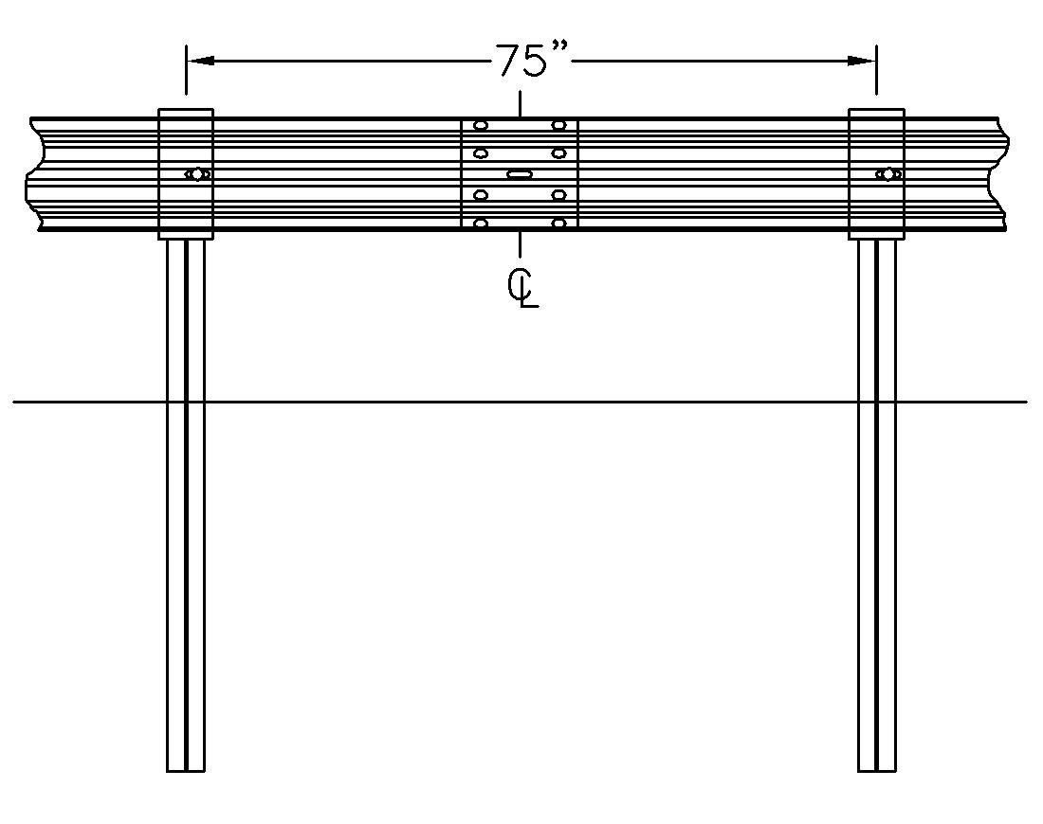
Midwest Guide Rail System (MGS)
Increased mounting height
Reduced post embedment
Mid-post splices
12” or 8” Blockouts

Slide 32
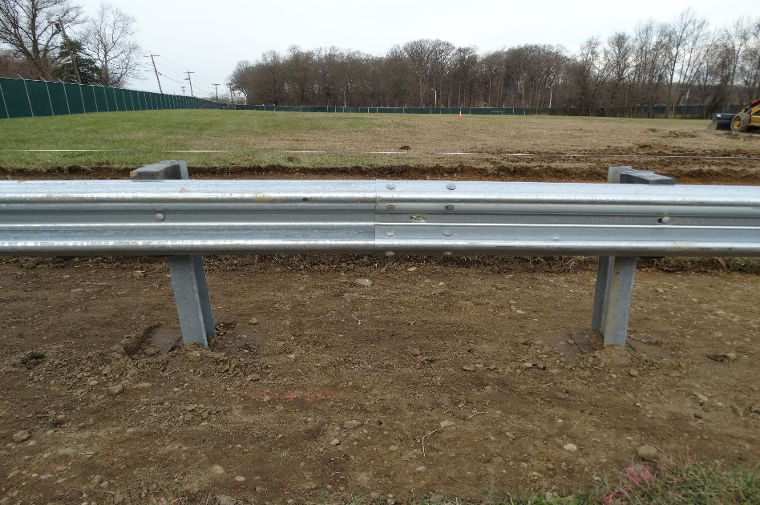
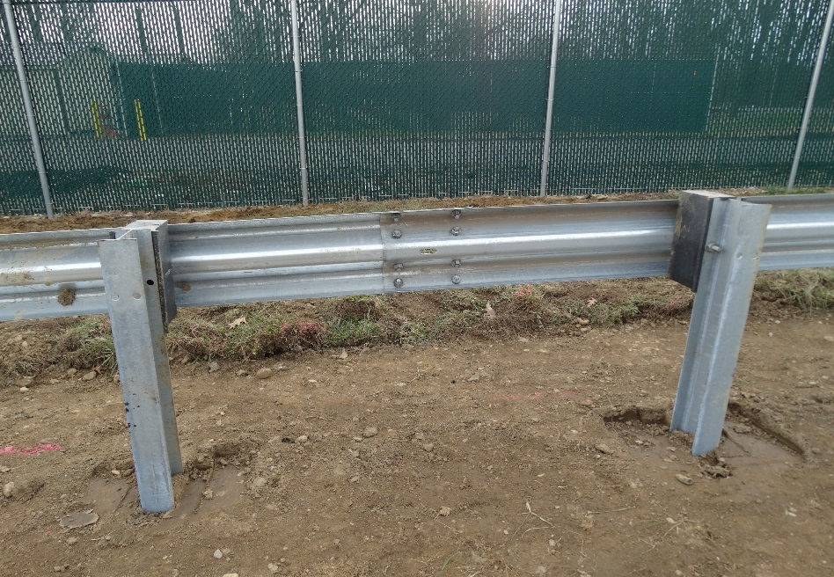
Midwest Guide Rail System (MGS)

Slide 33
MGS Advantages
Rail Stress reduced by:
Mid-span rail splice
Reduced post embedment
Better containment of higher mass and higher center of gravity vehicles

Slide 34
NJDOT MGS Guide Rail Detail
Mid-post splices
31” rail height
CD-609-1

Slide 35
Guide Rail Replacement Criteria
All new guide rail installations shall be constructed 31 inches high, see Standard Roadway Construction Details. The 31 inch high guide rail has a construction tolerance of +3/-3 inches.
Existing guide rail within the limits of a reconstruction project shall be replaced if it does not meet current offsets, height or splice location as shown in the Standard Roadway Construction Details. However, existing NCHRP 350 (i.e.: 27¼ inch high guide rail with synthetic blockouts) that does not need to be reset may be retained provided it is less than 20 years old (service life). The height of existing NCHRP 350 guide rail that is to remain must be between 26½ and 29 inches high.
On improvement projects to enhance safety, maintenance guide rail replacement projects and preventive maintenance projects, existing NCHRP 350 guide rail may be retained provided it is less than 20 years old. However, when at least 50 percent of an existing guide rail run is repaired, lengthened, reset or upgraded, then the entire run where practical shall be upgraded to the current 31 inch high standard including the approach guide rail transition and/or the end treatment.

Slide 36
Guide Rail Replacement Criteria
When only a portion of the existing guide rail is to be upgraded to the 31 inch height, the guide rail shall be transitioned as shown in the Standard Roadway Construction Detail CD-609-8.
Only NCHRP 350 guide rail (27¼ inch high guide rail with synthetic blockouts) can be left in place if the guide rail is less than 20 years old. NCHRP 230 guide rail (rail elements connected without rectangular washers to 14 inch high steel blockouts on 6’ long posts) and Pre-NCHRP 230 guide rail (rail elements connected with rectangular washers to 13” high steel blockouts on 5’-9” long posts) shall not be reset. Full replacement is the only option for NCHRP 230 and Pre-NCHRP 230 guide rail.

Slide 37
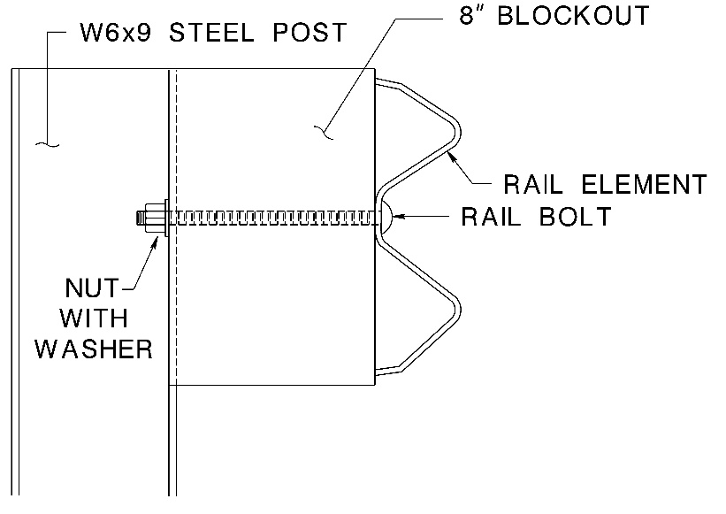
MGS Blockouts
MGS originally developed with 12” blockouts 8” blockouts are tested & approved
MGS 8” Blockout Test

Slide 38
MGS NCHRP 350 Test – Pickup Truck
4,378 lbs. – 61.0 mph – 25.6°
Dynamic deflection 43.1”

Slide 39
MGS NCHRP 350 Test – Small Car
1,956 lbs. – 63.9 mph – 20.0°
Dynamic deflection 17.4”

Slide 40
MGS MASH Test – Pickup Truck
5,000 lbs. – 62.9 mph – 25.5°
Dynamic deflection 43.9”

Slide 41
MGS MASH Test – Small Car
2,588 lbs. – 60.8 mph – 25.4°
Dynamic deflection 35.9”

Slide 42
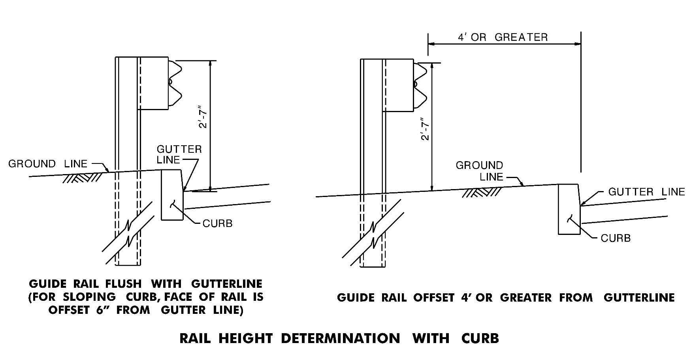
Midwest Guide Rail System (MGS)
Rail Mounting Height at Curb
CD-609-8A

Slide 43
Midwest Guide Rail System (MGS)
Vertical Transition to Existing
27¼” Guide Rail
Where transitioning to existing guide rail, an end terminal, or a crash cushion mounted at a height other than 2'-7", the vertical transition shall be accomplished in a minimum length of 12'-6" for each 2" of vertical change.
CD-609-8

Slide 44
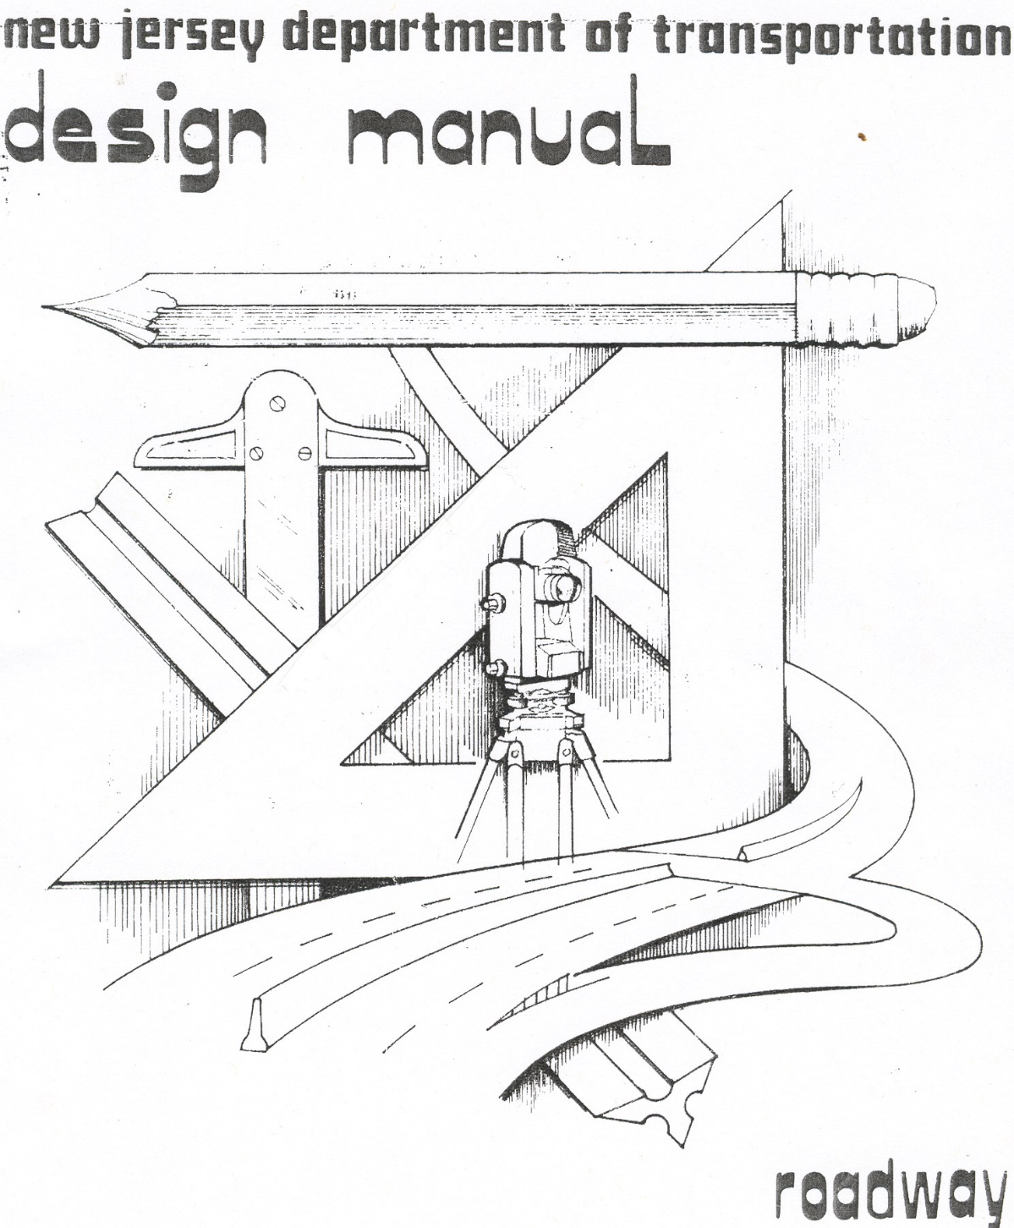

Slide 45
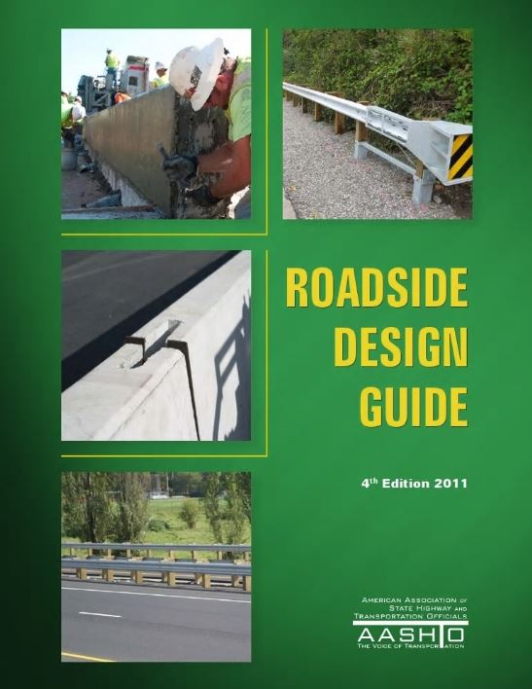

Slide 46
Figure 8-A Clear Zone (L_{C})
Clear Zone (L_{C} ) is defined as the area, starting at the edge of the traveled way, that is available for safe use by errant vehicles. The clear zone includes shoulders, bike lanes, acceleration and deceleration lanes. The clear zone for auxiliary lanes that function like through lanes will be measured from the outside edge of the auxiliary lane.
The Width of L_{C} varies with:
Design speed
Roadside slope
Horizontal roadway alignment

Slide 47
Figure 8-A Clear Zone (L_{C})
The following table contains the suggested range of clear zone distances on tangent sections of roadway based on selected traffic volumes, speed and roadside slopes:

Slide 48
Figure 8-C Horizontal Curve Adjustments for Clear Zone
The clear zone widths obtained from Figure 8-A should be increased on the outside of curves. The amount of increase can be determined by the following table:
C_{ZC} = (L_{C}) (K_{CZ})
L_{C} = Clear Zone distance from Figure 8-A (feet)
K_{CZ} = Curve Correction Factor
Clear zone correction factor is applied to outside of horizontal curves only. Curves flatter than 2,950 ft. do not require an adjusted clear zone. Also, adjustments are not necessary for design speeds less than 40 MPH.

Slide 49
Warranting Obstruction
Is defined as a non-traversable roadside or a fixed object located within the clear zone and whose physical characteristics are such that injuries resulting from an impact with the obstruction would probably be more severe than injuries resulting from an impact with guide rail.

Slide 50
Non-Traversable Roadside
Rough rock cuts
Large boulders
Streams or permanent bodies of water > 2’ in depth
Roadside channels with slopes steeper than 1H:1V & depths greater than 2’
Embankment slopes and slopes in cut sections as described in the following

Slide 51
Embankment Fill Slopes
A critical slope is one in which a vehicle is likely to overturn. IE: Slopes steeper than 3H:1V.
A non-recoverable slope is defined as one that is traversable but the vehicle can be expected to travel to the bottom of the slope before steering recovery can be obtained. IE: Slopes between 3H:1V and 4H:1V. A clear run out area at the base of these slopes is desirable, see Fig. 8-B.
A recoverable slope is 4H:1V or flatter
Table 8-1
Critical Slope Warrants
Critical Embankment (Fill) Slopes | Maximum Height Without Guide Rail
1½ H:1V | 3 ft.
2H:1V | 6 ft.
2½ H:1V | 9 ft.

Slide 52
Fixed Objects That Warrant Guide Rail
Overhead sign supports (protect even when outside clear zone)
Concrete pedestals extending > 4” above ground.
Bridge piers
Abutments
Ends of parapets & railings
Wood poles or posts with cross sectional area > 50 sq. inches (8 inch diameter)
Drainage structures

Slide 53
Fixed Objects
In no case shall breakaway, bendaway or non-breakaway design supports, highway lighting, trees, utility poles, fire hydrants, mailboxes & signs on new or upgraded guide rail installations remain in front of guide rail.

Slide 54
Trees
Any size diameter considered fixed object
Trees are not a warranting obstruction for guide rail since guide rail is not installed solely for shielding trees.
Existing trees < 4’ from back of rail element shall be removed, regardless of size.
Trees that should be removed from clear zone:
Block or obscure horizontal sight distance
Sick & diseased trees beyond reasonable repair
Dead trees
Significant accident history

Slide 55
Remove Trees And Vegetation 4’ Behind Guide Rail

Slide 56
Utility Poles
Although they have cross sectional area > 50 Sq. Inches (8” diameter), they should not be handled the same way as other warranting obstructions
Locate as close to ROW line as practical
Utility pole offset reference: Utility Accommodation Regulation (NJ 16:25)
Quick Ref: NJDOT Design Criteria for Above Ground Utilities
Any utility pole that has been struck 3 or more times within 3 years should require corrective action. This also includes neighboring poles
Do not place in small islands, gore areas or on outside of sharp horizontal curves
Do not place poles (new or old) in front of guide rail

Slide 57
Where Utility Poles Are Placed Behind Guide Rail
Desirably, face of pole should be ≥ 4’ from face of rail.
Where < 4’, provide reduced post spacing - face of pole 1.5’ min. from face of rail.
Where pole is located directly behind guide rail post, use 6” min. pole offset from back of post.
Utility poles shall not be placed within the adjacent & advanced recovery area, Figure 8-D

Slide 58
Don’t Attach Utility Pole Guy Wires to Guide Rail

Slide 59
Fire Hydrants
Fixed object that may warrant guide rail. Same logic as utility poles
Locate fixed objects as far from the traveled way as possible
Do not place in front of guide rail
Where hydrant is placed behind guide rail, raise hydrant (3’ max.) so connection can be made over the guide rail. Less desirable treatment is provide short opening in guide rail

Slide 60
Fire Hydrants

Slide 61
Mailbox Support
See 4th Edition 2011 Roadside Design Guide,
“Chapter 11 Erecting Mailboxes On Streets and Highways” for mailbox regulations, design, & details

Slide 62
Guide Rail At Top Of Embankment Slope
Where guide rail is located at the top of an embankment slope, the posts should be a minimum of 2 ft. from the PVI to the back of the post. When less than 2 ft. is provided, the following post lengths, shown in Table 8-3 below, should be used:
Table 8-3
Additional Post Length Requirements Where Distance From PVI to Back of Post is Less Than 2 Feet
Offset from Back of Post to PVI | Embankment Slopes | Additional Post Length
Less than 2 ft. but greater or equal to 1 ft. | 6H:1V or Flatter | No Change
 | Steeper than 6H:1V to 3H:1V | 1 ft.
 | Steeper than 3H:1V to 2H:1V | 2 ft.
Less than 1 ft. or at PVI | 6H:1V or Flatter | 1 ft.
 | Steeper than 6H:1V to 3H:1V | 2 ft.
 | Steeper than 3H:1V to 2H:1V | 3 ft.
Guide rail shall be placed on slopes 10H:1V or flatter provided the rollover
between the pavement slope and the embankment slope is not greater than
10 percent. Rollovers greater than 10 percent are more prone to occur where
superelevation slopes in opposite direction of the embankment slope. Where
this happens, install guide rail flush to the gutter line.

Slide 63
MGS Mash Test – 2270P (5000 lb)
9’ Long Posts located at the PVI
6’-3” post spacing, 2:1 slope

Slide 64
Curb or Raised Berm in Front of Guide Rail
Interstates & freeways: new vertical curb shall not be constructed. However, 4” max. height sloping curb may be constructed on urban freeways & Interstates
Land service highways: avoid curb or raised berm where possible
Where raised berm cannot be removed, regrade at 6:1 with 4” max. height

Slide 65
If vertical or sloping curb is present & cannot be removed, Guide Rail offsets are:
Posted Speed > 50 MPH
Flush with gutter line for vertical curb and 6” behind gutter line for sloping curb
Posted Speed 40 to 50 MPH
Preferred location: flush with gutter line for vertical curb and 6” behind gutter line for sloping curb
Freeway or Interstate: may be offset 4’ to 12’ behind gutter line. 10’ to 12’ preferred for safe mowing operations
Land service: may be offset 6’ to 12’ behind gutter line where there is sidewalk or sidewalk area used by pedestrians
Posted Speed ≤ 40 MPH
Freeway or Interstate ramps: 4’ or more
Land service roads: any distance behind the gutter line, 6’ to 12’ preferred

Slide 66
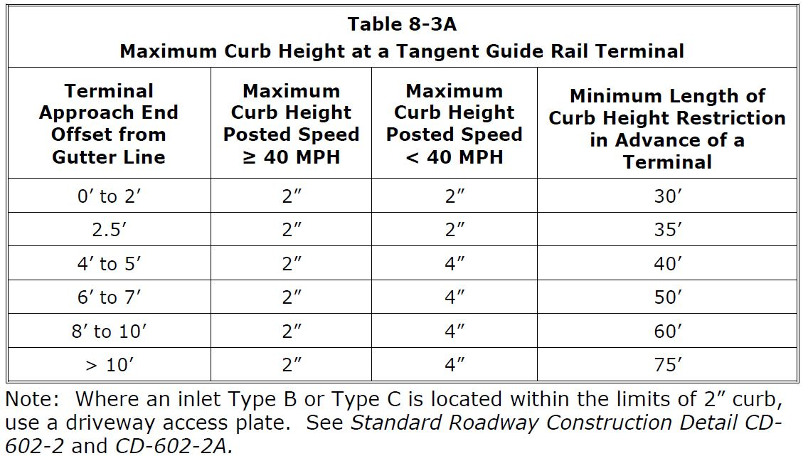
Curb in Front of Tangent Guide Rail Terminal (BDC18MR-01)
Where there is curb at a tangent guide rail terminal, the maximum curb height along the length of the terminal and in advance of the terminal varies based on offset and posted speed as shown in Table 8-3A.

Slide 67
Curb Transition at Tangent Guide Rail Terminal (BDC18D-07)
CD-607-2.1

Slide 68
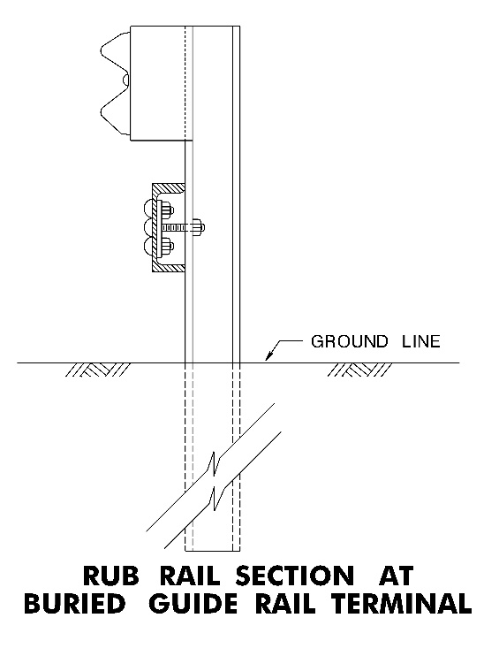
Rub Rail (CD-609-3) Median Guide Rail and Buried End Terminal
Rub Rail is required in the median where the swale slope is steeper than 10:1 See Figure 8-W.
Rub Rail is required at a Buried End Terminal where the distance from the bottom of rail to the ground exceeds 21 inches.
See CD-609-9

Slide 69
Standard 6’-3” Post Spacing Where Clearance From Back of Rail to Obstruction is 4’ or Greater
In a fill section where the distance from the back of the post to the PVI is less than 1’ and the slope is steeper than 3:1, the minimum clearance from the face of the rail to an obstruction is increased by 1’ due to increased post deflection.
CD-609-8.1

Slide 70
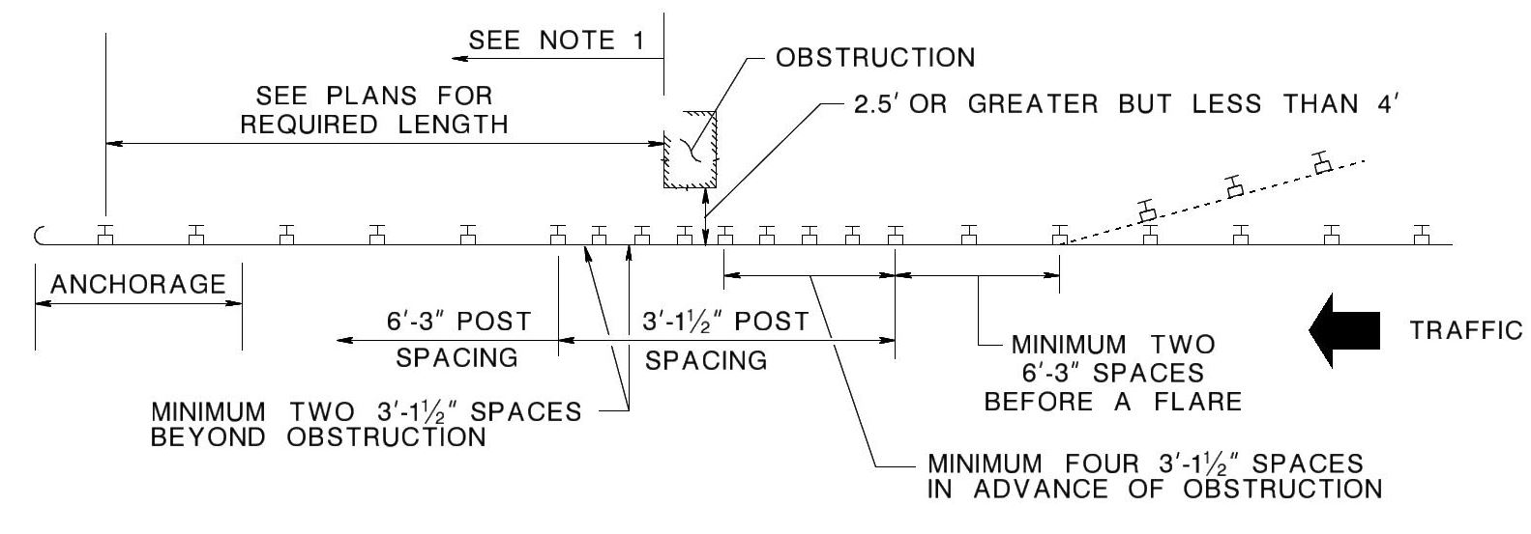
Half Post Spacing – 3’-1½”
Where Clearance From Back of Rail to Obstruction is 2.5’ or Greater but Less Than 4’
Where an approach end treatment at the trailing end of guide rail is shown on the plans, the post spacing requirements shall be the same as the approach end.
In a fill section where the distance from the back of the post to the PVI is less than 1’ and the slope is steeper than 3:1, the minimum clearance from the face of the rail to an obstruction is increased by 1’ due to increased post deflection.
Addition posts and blockouts will be paid for under pay item “Beam Guide Rail Post”.
CD-609-8.1

Slide 71
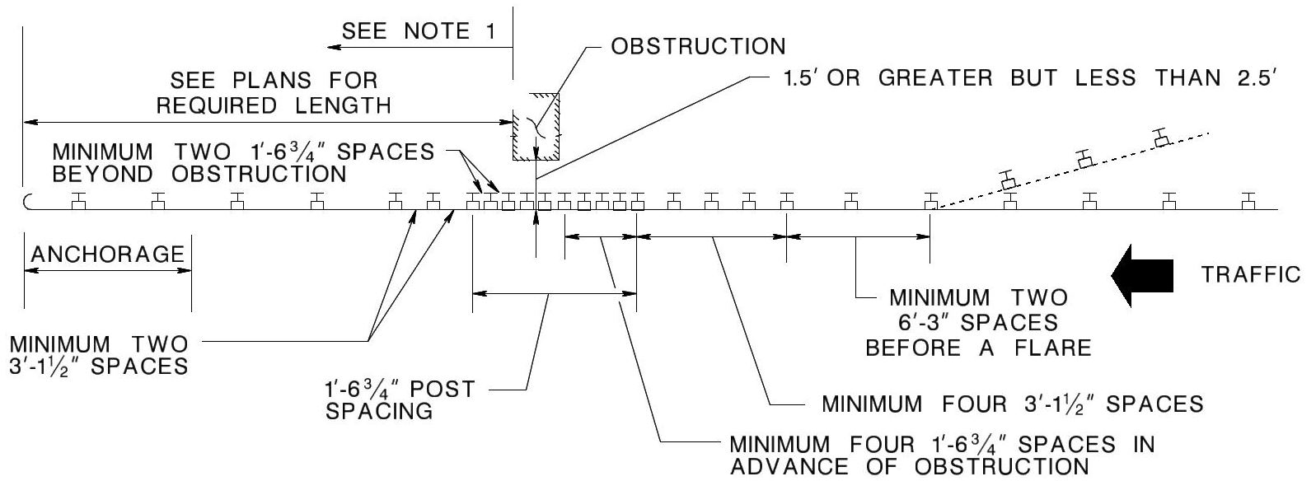
Quarter Post Spacing – 1’- 6¾”
Where clearance From Back of Rail to Obstruction is 1.5’ or Greater but Less Than 2.5’
Where an approach end treatment at the trailing end of guide rail is shown on the plans, the post spacing requirements shall be the same as the approach end.
In a fill section where the distance from the back of the post to the PVI is less than 1’ and the slope is steeper than 3:1, the minimum clearance from the face of the rail to an obstruction is increased by 1’ due to increased post deflection.
Addition posts and blockouts will be paid for under pay item “Beam Guide Rail Post”.
CD-609-8.1

Slide 72
MGS Test
Quarter Post Spacing – 1’- 6¾”
Dynamic deflection = 17.6”

Slide 73
Reduced Post Spacing At Obstruction

Slide 74
No Reduced Post Spacing Aftermath

Slide 75
Underground Structures
When the installation of guide rail posts would impact an under ground structure (pipe, fiber optic cable, junction box, inlet, etc.) and it is not practical to adjust the location the underground structure or the guide rail posts, the designer has the option of:
adding additional blockouts
omitting one to three guide rail posts (12’-6”, 18’-9” or 25’-0” unsupported span lengths)
attaching the guide rail to a concrete sidewalk

Slide 76
MGS Guide Rail – Additional Blockouts
one additional blockout may be provided at each post for any length of guide rail.
two additional blockouts may be provided, but are limited to only one post in any 75 feet of guide rail.
Additional blockouts are not permitted within the limits of guide rail terminals.

Slide 77
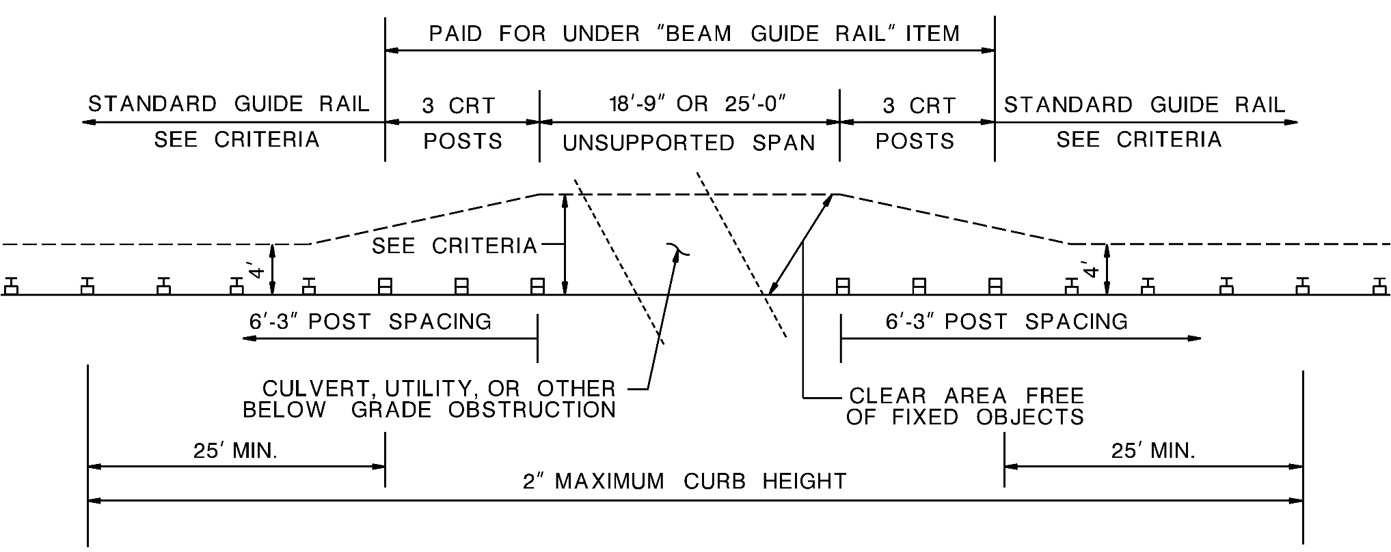
25’ or 18’-9” Unsupported Span
CD-609-8A

Slide 78
MGS Guide Rail – Omitted Posts (25’ or 18’-9” Unsupported Span)
Minimum distances from outer CRT posts
62.5’ between consecutive unsupported spans
62.5’ and 87.5’ to the approach end of a tangent or flared terminal respectively
50’ to beginning of a flare
62.5’ to a beam guide rail anchorage
37.5’ to a W-beam asymmetrical transition section
to fixed objects – 7’ & 8’ for 18’-9” & 25’-0” spans respectively
2’ from back of post to PVI on fill slopes
3’ minimum to a vertical drop off behind unsupported span
2 inch maximum extension of culvert headwall above ground line behind unsupported span
Where curbed, the curb height thru the unsupported span and for a minimum of 25’ beyond outer CRT posts shall not be greater than 2”
Unsupported span lengths of 18’-9” and 25’-0” shall be constructed as shown in Standard Roadway Construction Detail CD-609-8A.
Show the location of a proposed unsupported span including the length of the unsupported span on the construction plans.

Slide 79
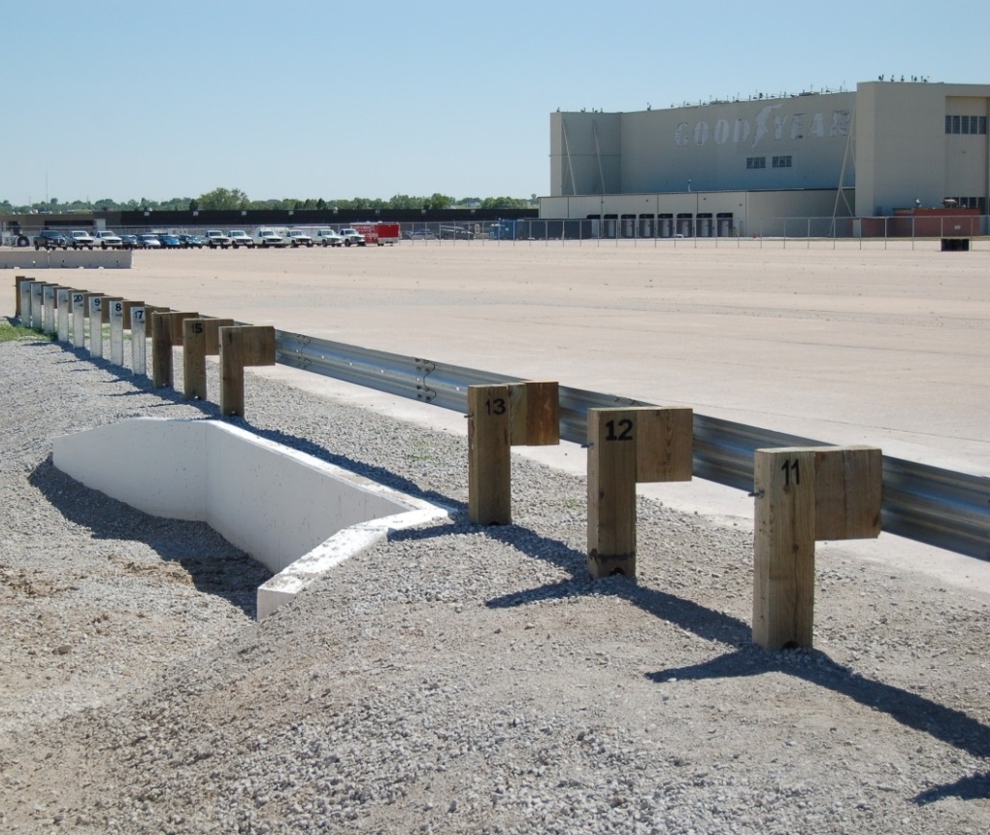
MGS Guide Rail – Omitted Posts (Unsupported Span)
25’ Unsupported Span
3 CRT posts on approach & trailing ends

Slide 80
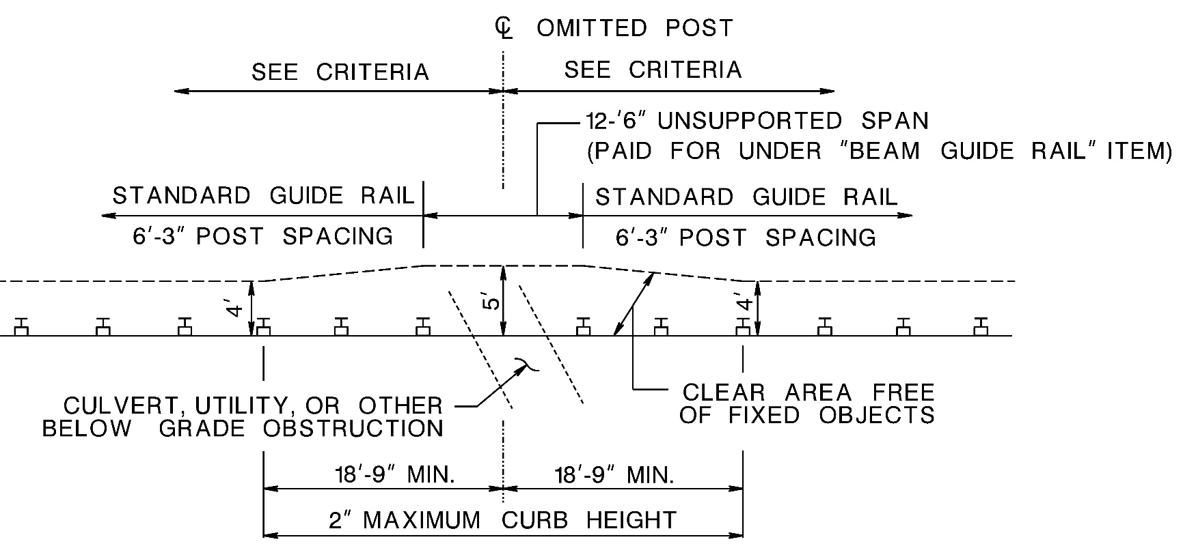
12’-6” Unsupported Span
CD-609-8A

Slide 81
MGS Guide Rail – Omitted Posts (12’-6” Unsupported Span)
Minimum distance from omitted posts
56.25 feet between two consecutive post omissions.
62.5 feet and 68.75 feet from the approach end of a tangent terminal or a flared terminal respectively
31.25 feet from the beginning of a flare or reduced post spacing.
62.5 feet from the last post of a beam guide rail anchorage
37.5 feet from the upstream end of a thrie beam to W-beam asymmetrical transition
43.25 feet from an outer CRT post of an 18’-9” or 25-0”’ unsupported span.
Fixed objects within the limits of the unsupported span must be a minimum of 5 feet behind the face of rail
Where there is curb at the omitted post, the curb height shall not be greater than 2 inches for 18’-9” on both the approach and trailing end of the omitted post.
The 12’-6” unsupported span shall be constructed as shown in Standard Roadway Construction Detail CD-609-8A.
The designer must show the location of a proposed 12’-6” unsupported span on the construction plans.

Slide 82
MGS 25’ Unsupported Span Test
4,985 lbs. - 61.9 mph - 24.9°
Overhead View

Slide 83
MGS 25’ Unsupported Span Test
4,985 lbs. - 61.9 mph - 24.9°
Ground Level View

Slide 84
Concrete Sidewalk
Where an underground structure would require an unsupported span length greater than 25’-0” or where the minimum offset to a fixed object for unsupported spans cannot be provided:
provide 8” min. thick sidewalk with guide rail posts bolted to the sidewalk
The width of the sidewalk shall be the same as required for the nonvegetative surface shown in Standard Roadway Construction Detail CD-608-1
Standard Roadway Construction Detail CD-609-11 illustrates the method for attaching guide rail to a sidewalk.

Slide 85
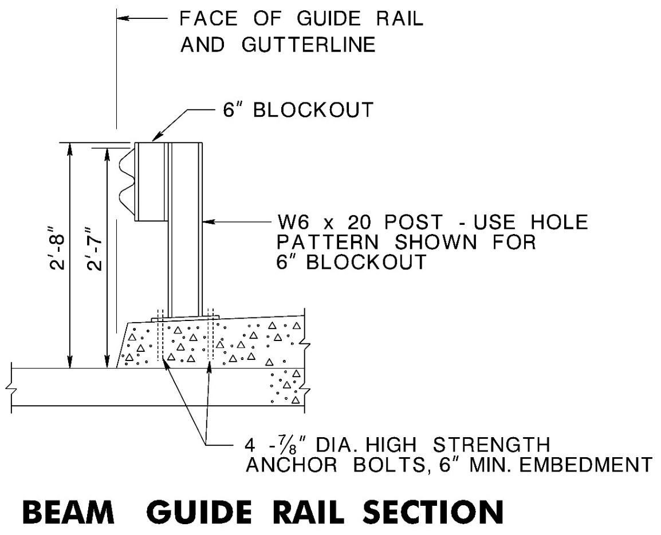
W-Beam Guide Rail Attachment to Sidewalk
31” Rail Height from Gutterline
Sidewalk:
Min. 8” thick
Min. width = nonvegetative requirements on CD-608-1
CD-609-11

Slide 86
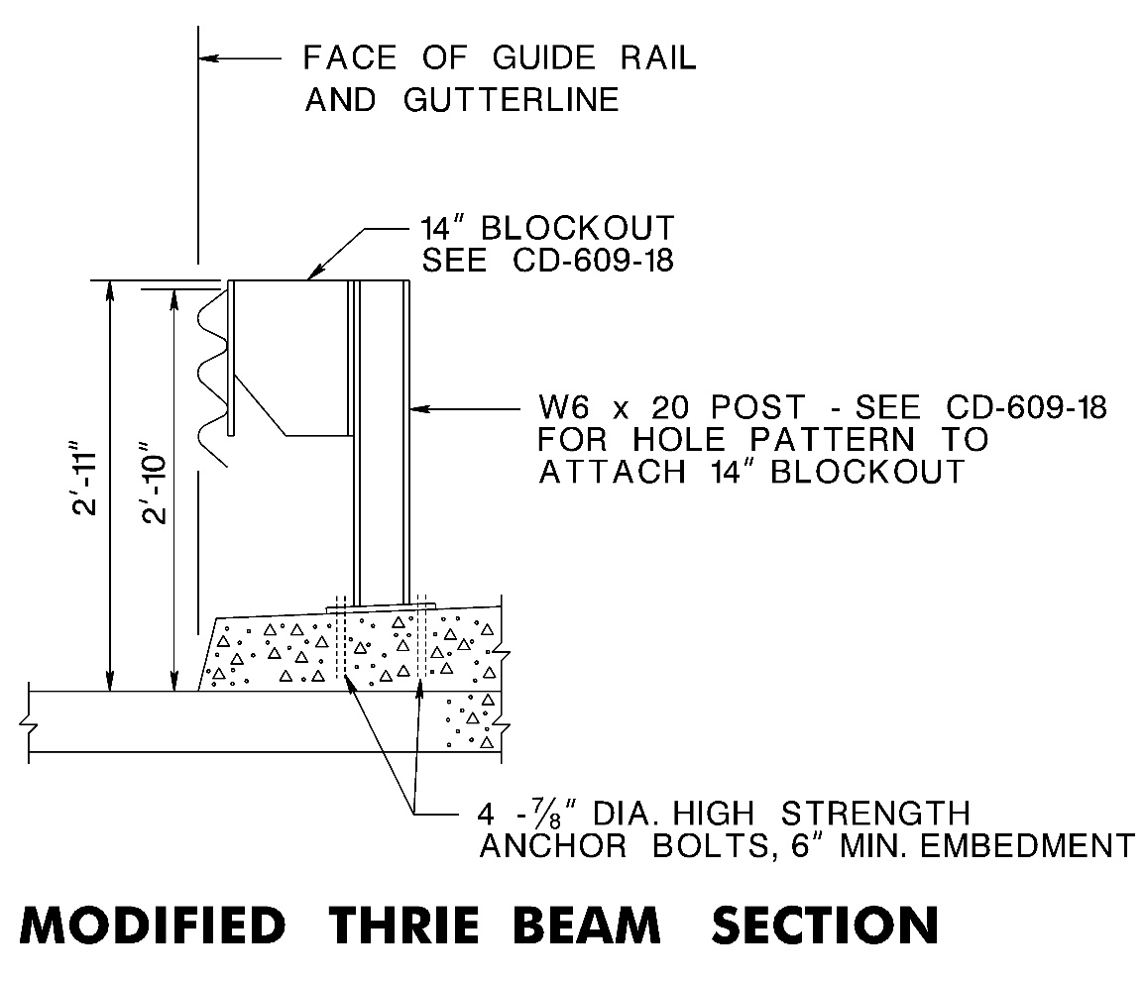
Modified Thrie Beam Attachment to Sidewalk
34” Rail Height from Gutterline
Sidewalk:
Min. 8” thick
Min. width = nonvegetative requirements on CD-608-1
CD-609-11

Slide 87
Safety Walks (1.5’ to < 4’ Wide) on Existing Freeways & Interstates
Where not feasible to remove & provide concrete barrier shaped parapet, carry guide rail across bridge.
Existing freeways & Interstate ramps ≤ 40 mph & sidewalk ≤ 2.5’ in width, it is not necessary to carry guide rail across structure since vaulting is not likely to occur. In this case guide rail should be provided across structure only if parapet is not crashworthy.
Beam GR with RR across bridge Thrie Beam GR across bridge
(Rubrail no longer required)

Slide 88
Thrie Beam Across Bridge

Slide 89
Curb or Berm on Structure Approaches
On structures, the guide rail mounting height is measured from gutter line provided face of guide rail is flush with curb face.

Slide 90
Umbrella Section on Bridge Approaches
Guide rail mounting height on the structure is measured from gutter line & face of guide rail is flush with curb.

Slide 91
Guide Rail at Structures (NCHRP 230) See Attachment Details CD-609-11 Thru 17E
NCHRP 230 steel I-beam blockouts

Slide 92
Guide Rail at Structures (NCHRP 350) See Attachment Details CD-609-11 Thru 17E
Before
After
Tubular steel blockouts

Slide 93
Guide Rail at Structures (NCHRP 350)

Slide 94
Guide Rail Attachment to Barrier Curb (NCHRP 230)
NCHRP 230 steel I-beam blockouts

Slide 95
Guide Rail at Structures, Trailing End (NCHRP 350) See Attachment Details CD-609-11 Thru 17E
Before
After

Slide 96
Thrie Beam Bridge Connections

Slide 97
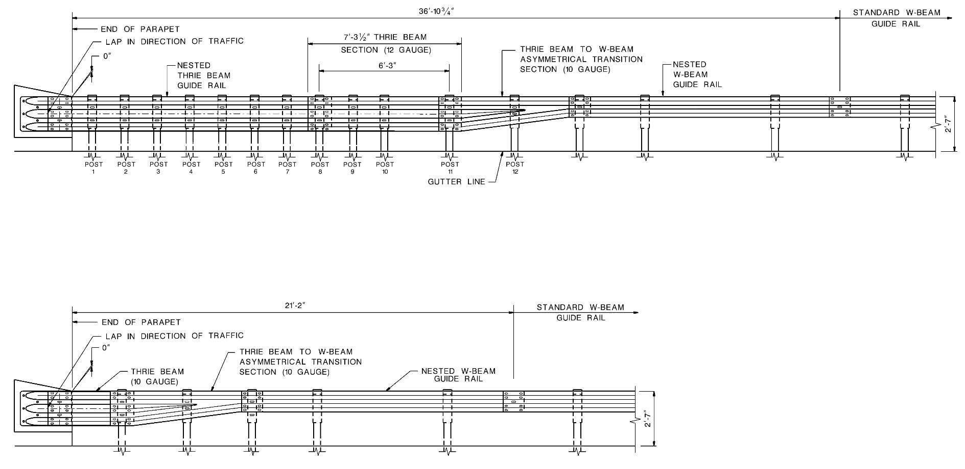
MASH TL-3 & TL-2 AGT Comparison
TL-3 design speed > 45 MPH
TL-2 design speed 45 MPH or less

Slide 98
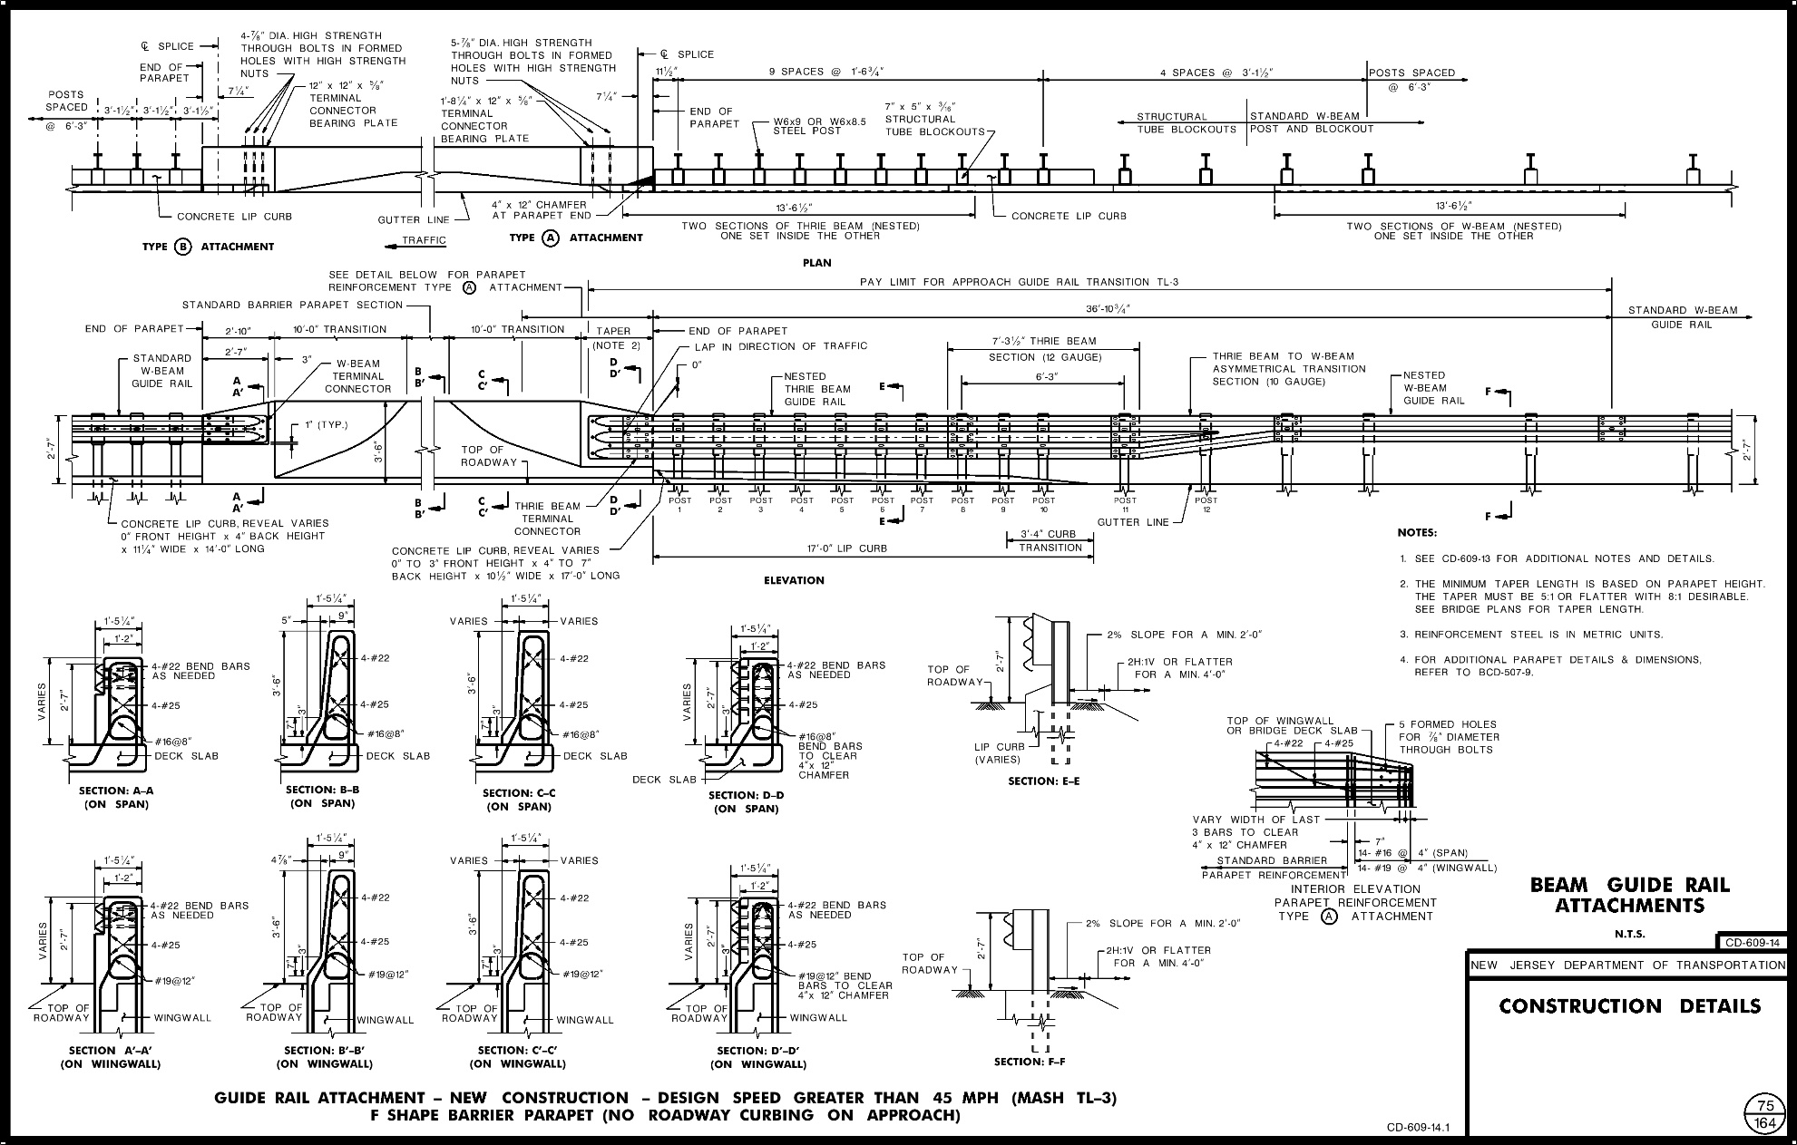
MASH TL-3 AGT to F Shape Parapet - No Curbing
CD-609-14

Slide 99
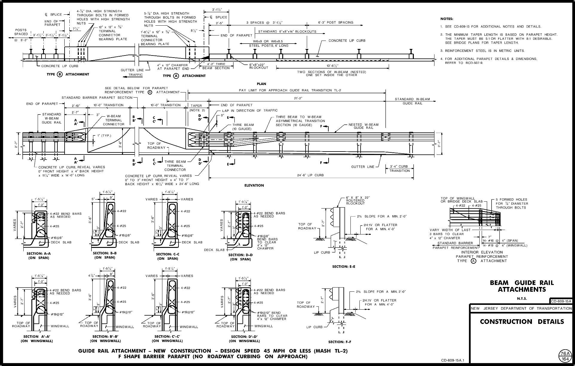
MASH TL-2 AGT to F Shape Parapet No Curbing
CD-609-15A

Slide 100
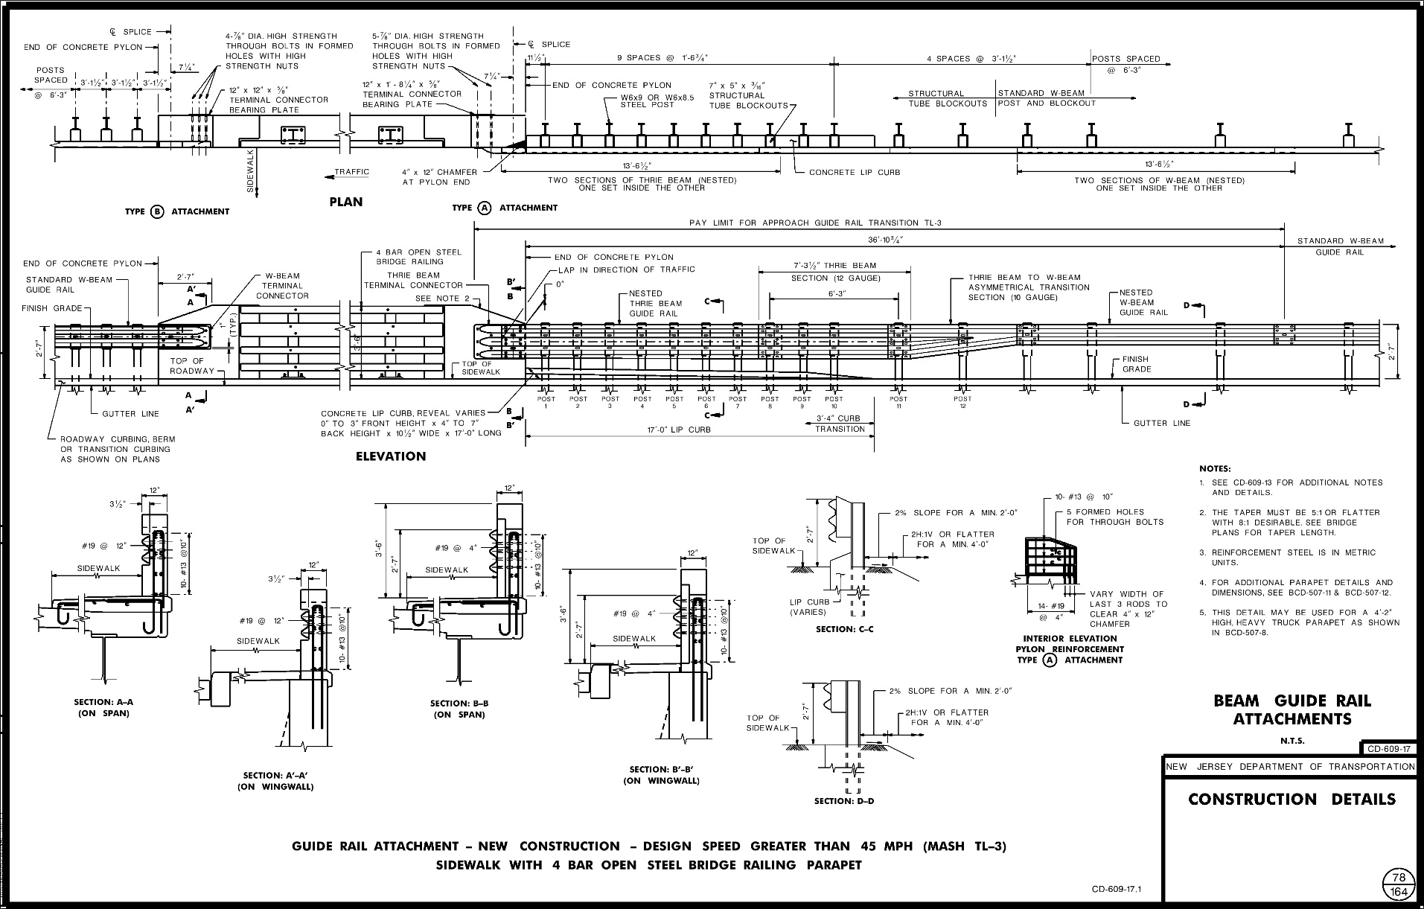
MASH TL-3 AGT to Four Bar Parapet
CD-609-17

Slide 101
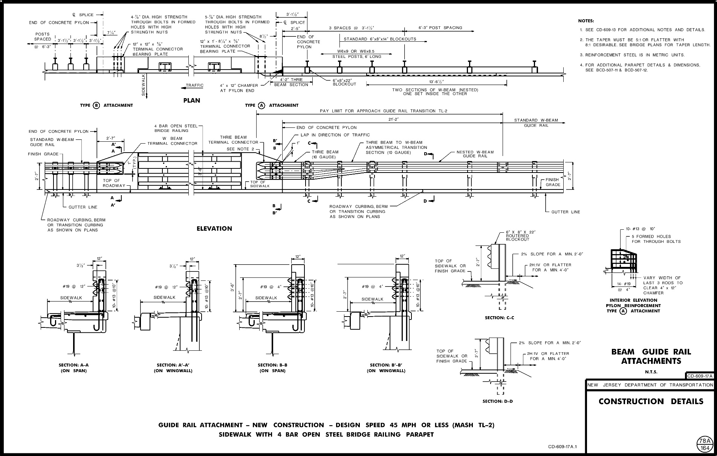
MASH TL-2 AGT to Four Bar Parapet
CD-609-17A

Slide 102
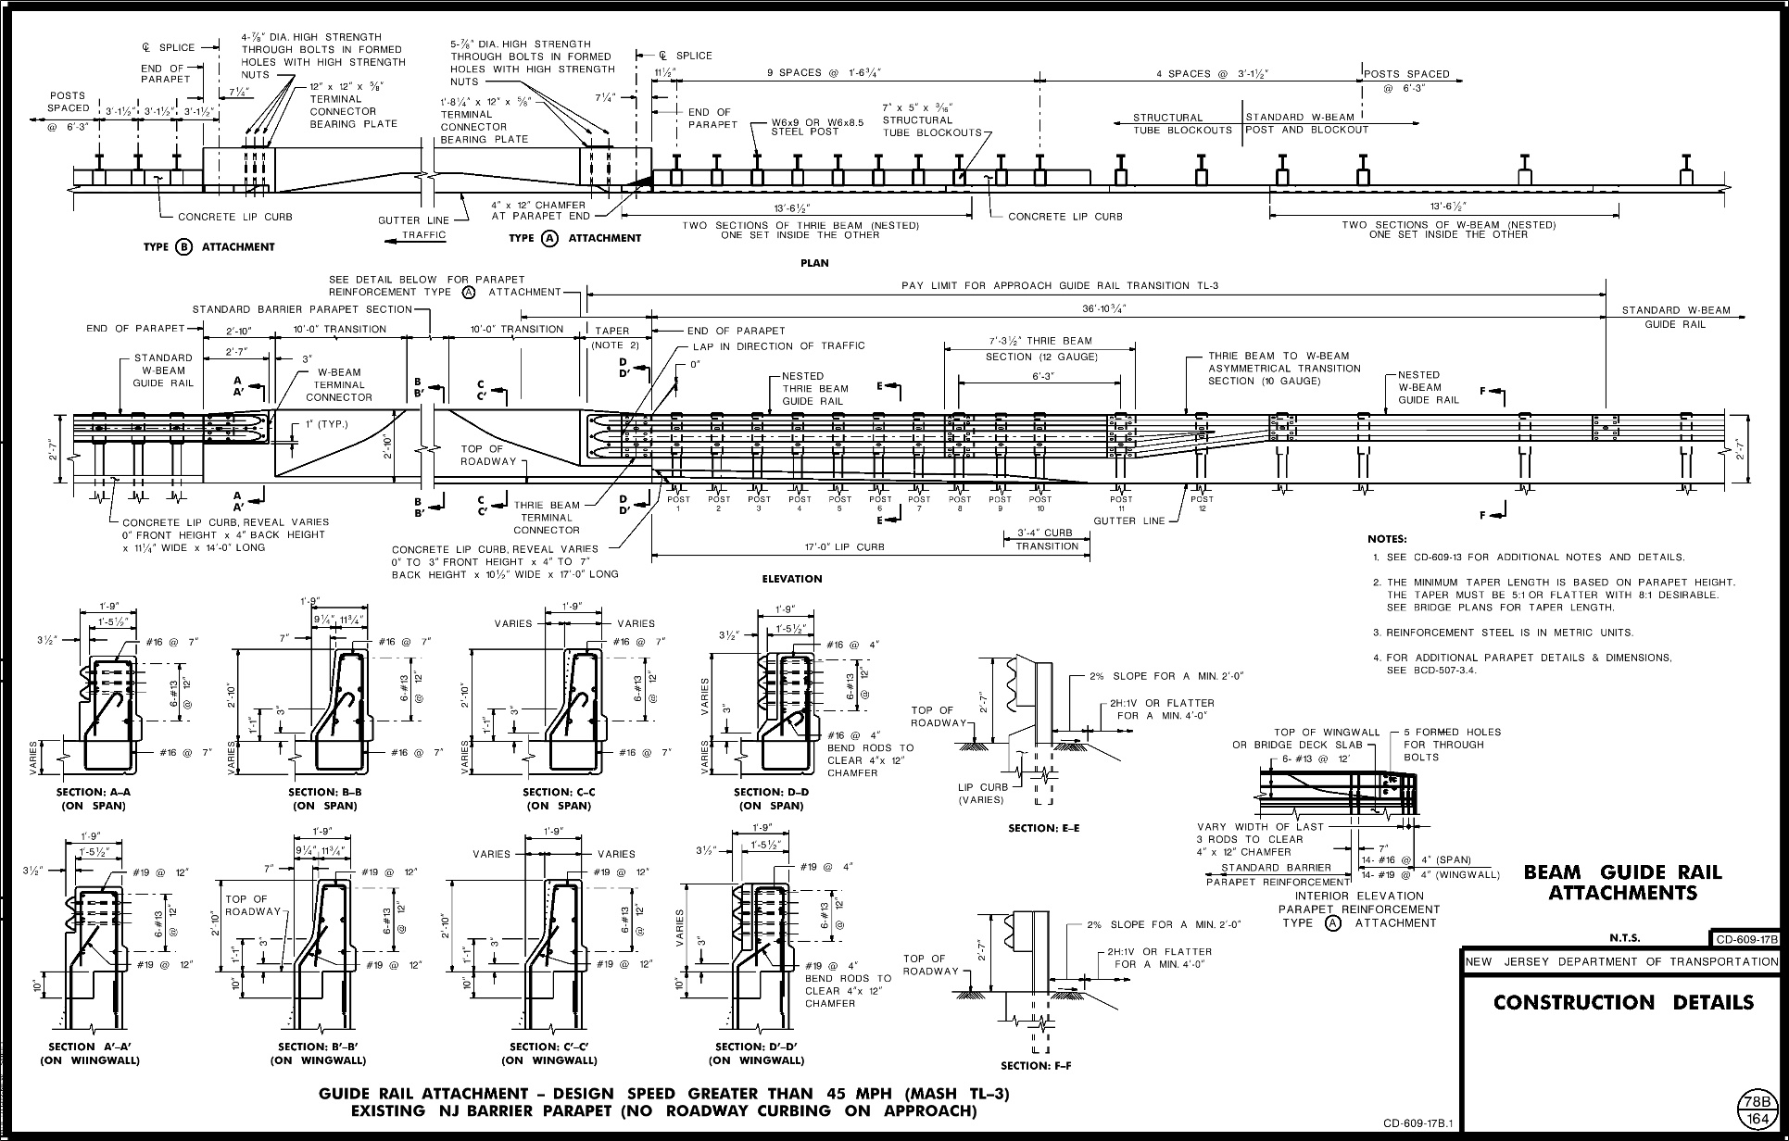
MASH TL-3 AGT to Existing NJ Barrier Parapet No Curbing
CD-609-17B

Slide 103
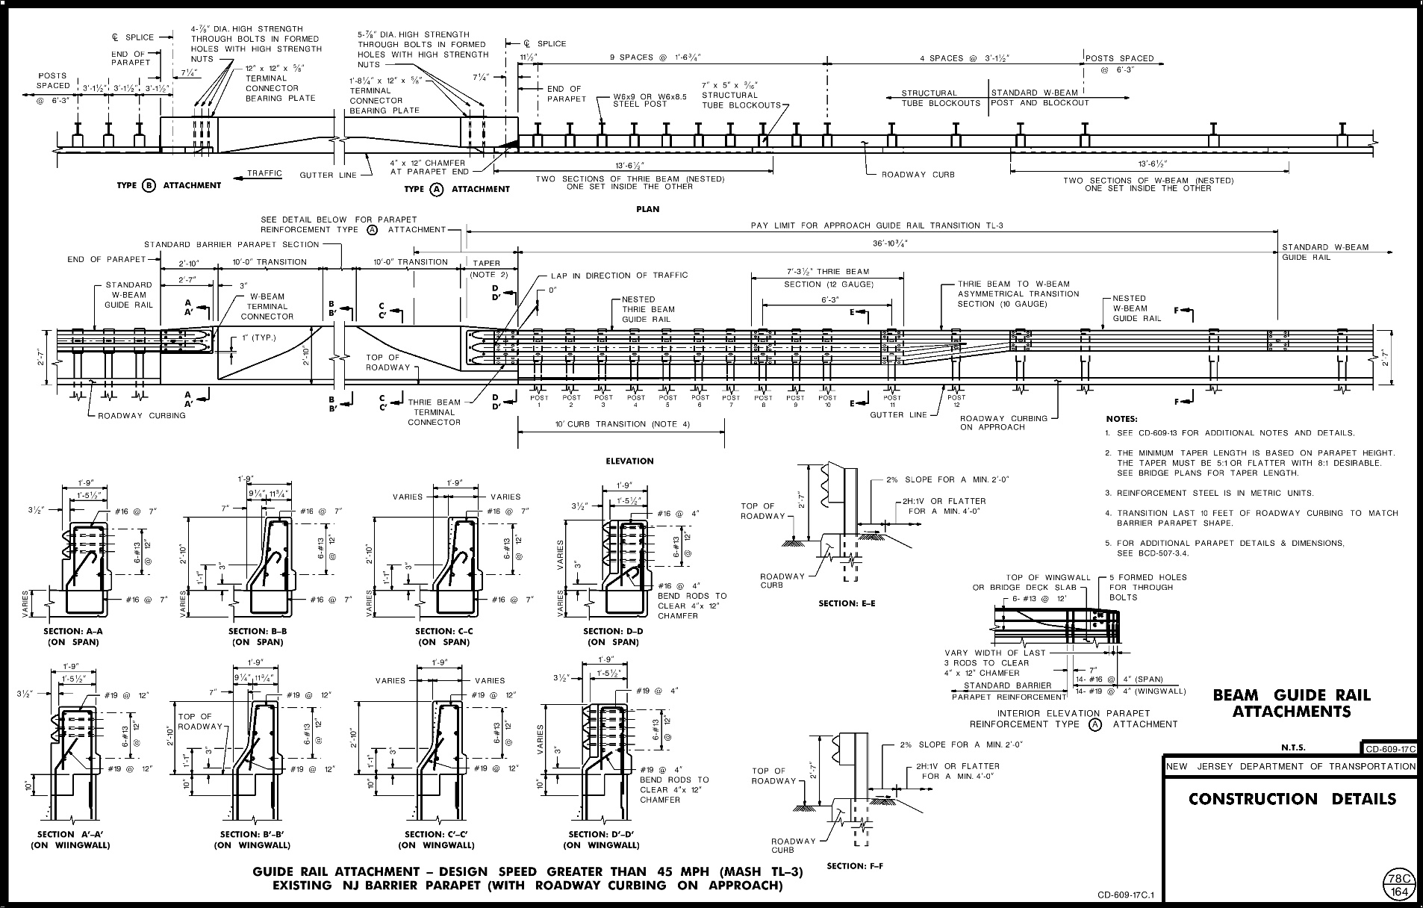
MASH TL-3 AGT to Existing NJ Barrier Parapet with Curbing
CD-609-17C

Slide 104
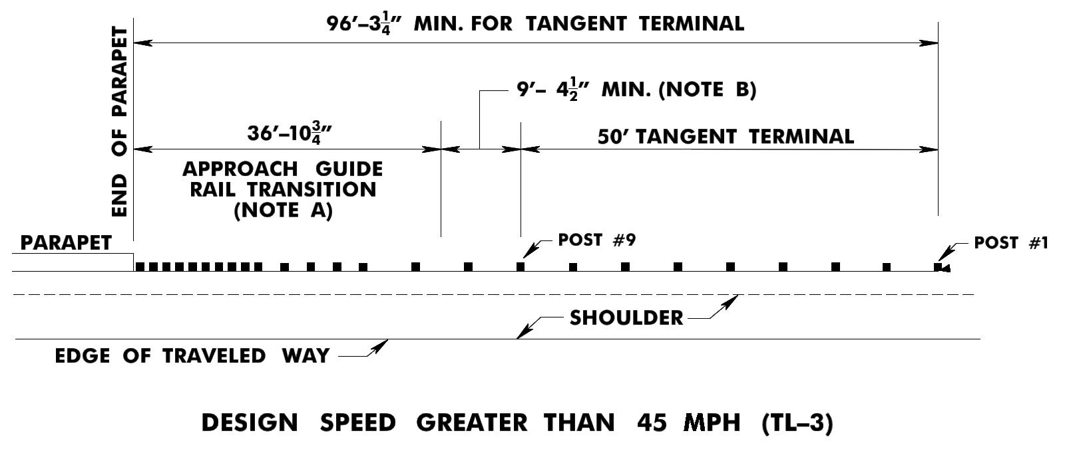
Figure 8-O2
TL-3 AGT Minimum Length of Guide Rail
at Tangent Terminals (BDC18D-07)
NOTES
A. See Standard Roadway Construction Details.
B. Any multiple of 6'-3" may be added to the minimum length.
C. The designer should indicate the type of attachment on the plans (TL-2 or TL-3).

Slide 105
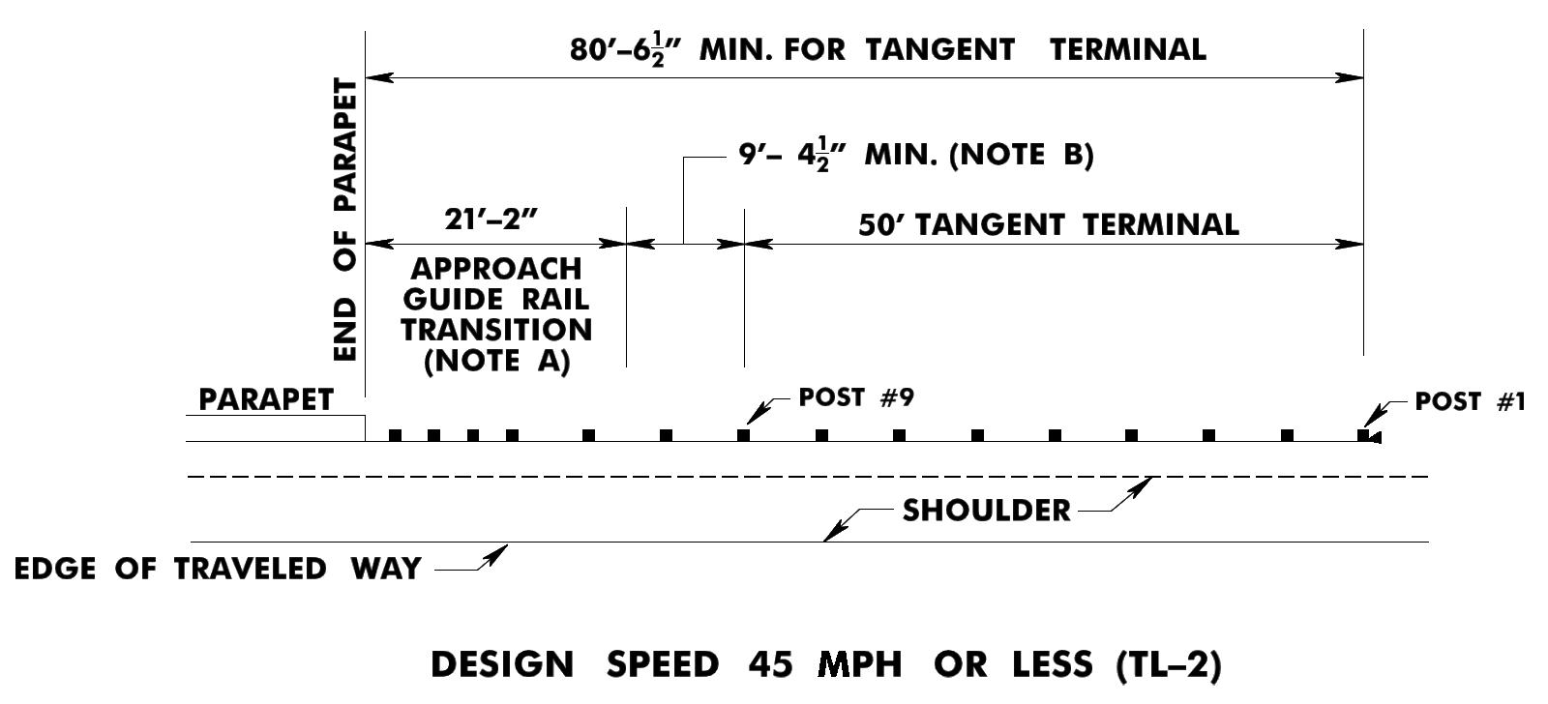
Figure 8-O2
TL-2 AGT Minimum Length of Guide Rail
at Tangent Terminals (BDC18D-07)
NOTES
A. See Standard Roadway Construction Details.
B. Any multiple of 6'-3" may be added to the minimum length.
C. The designer should indicate the type of attachment on the plans (TL-2 or TL-3).

Slide 106
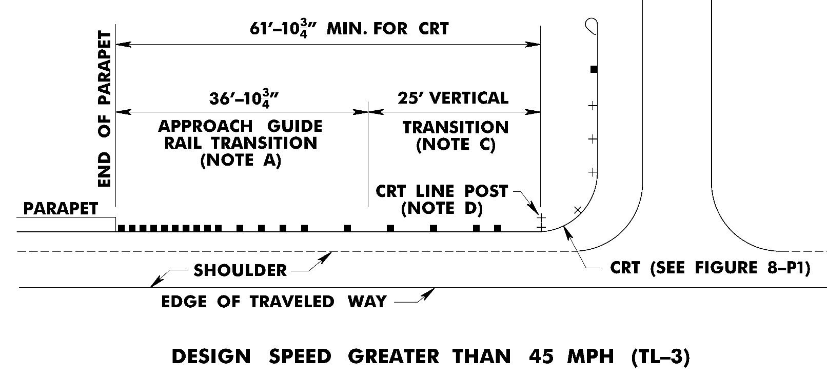
Figure 8-P2
TL-3 AGT Minimum Length of Guide Rail
at a Controlled Release Terminal
NOTES
A. See Standard Roadway Construction Details.
B. The designer should indicate the type of attachment on the plans (TL-2 or TL-3).
A minimum 25' vertical transition is required to transition from 31" MGS rail height to 27.25" CRT rail height. See CD-609-6.
D. See CD-609-6 for location of CRT line post for various CRT radii.

Slide 107
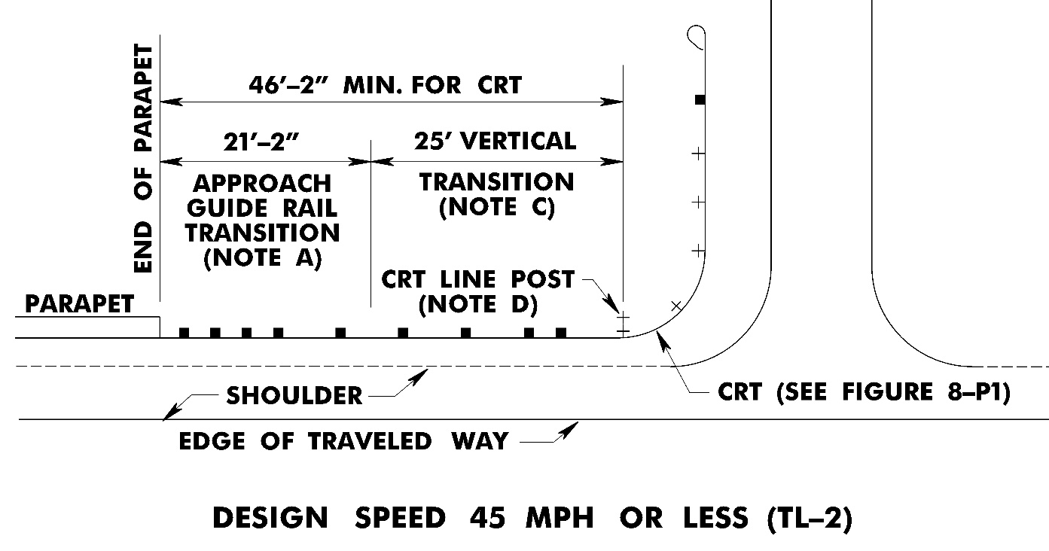
Figure 8-P2
TL-2 AGT Minimum Length of Guide Rail
at a Controlled Release Terminal
NOTES
A. See Standard Roadway Construction Details.
B. The designer should indicate the type of attachment on the plans (TL-2 or TL-3).
A minimum 25' vertical transition is required to transition from 31" MGS rail height to 27.25" CRT rail height. See CD-609-6.
D. See CD-609-6 for location of CRT line post for various CRT radii.

Slide 108
For the structural design of bridge parapets/pylons, see:
NJDOT Bridge Manual, sixth edition, 2016, “Section 23.3 Types of Bridge Railings.”

Slide 109
BDC18MR-01 & BDC18D-07 Major Changes
Eliminated Flared Guide End Terminal.
Table 8-3A added to Section 8.3.2.A providing limits for 2” curb height based on Tangent Guide Rail Terminal offsets and posted speed.
Table 8-3B added to Section 8.3.2.B providing limits for 2” curb height based on Beam Guide Rail Anchorage offsets and posted speed.

Slide 110
END PART 1

